Slide 1
Welcome to Bible Class
欢迎参加圣经课程
The Messiah in the Old Testament
旧约中的弥赛亚

Slide 2
Part 3
第三部分
THE MESSIAH IN THE PSALMS
诗篇中的弥赛亚
Lesson 9 = The Messiah Does God’s Will (Psalm 40)
第九课=弥赛亚行神的旨意（诗40）
Lesson 10 = The Messiah is Crucified (Psalm 22)
第十课=弥赛亚被钉十字架（诗22）
Lesson 11 = The Messiah is the Risen Lord (Psalm 16)
第十一课=弥赛亚是复活的主（诗16）
Lesson 12 = The Messiah is the King of Glory (Ps 2 & 110)
第十二课=弥赛亚是荣耀的君王（诗2及诗110）

Slide 3
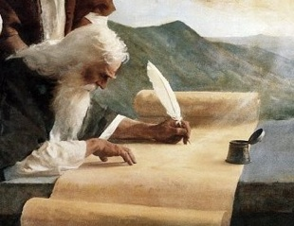
“They still did not understand from Scripture that Jesus had to rise from the dead.” (John 20:9)
“因为他们还不明白圣经的意思，就是耶稣必要从死里复活。”（约20:9）
“that he was buried, that he was raised on the third day according to the Scriptures” (1 Corinthians 15:4)
“而且埋葬了。又照圣经所说，第三天复活了。”（林前15:4）

Slide 4
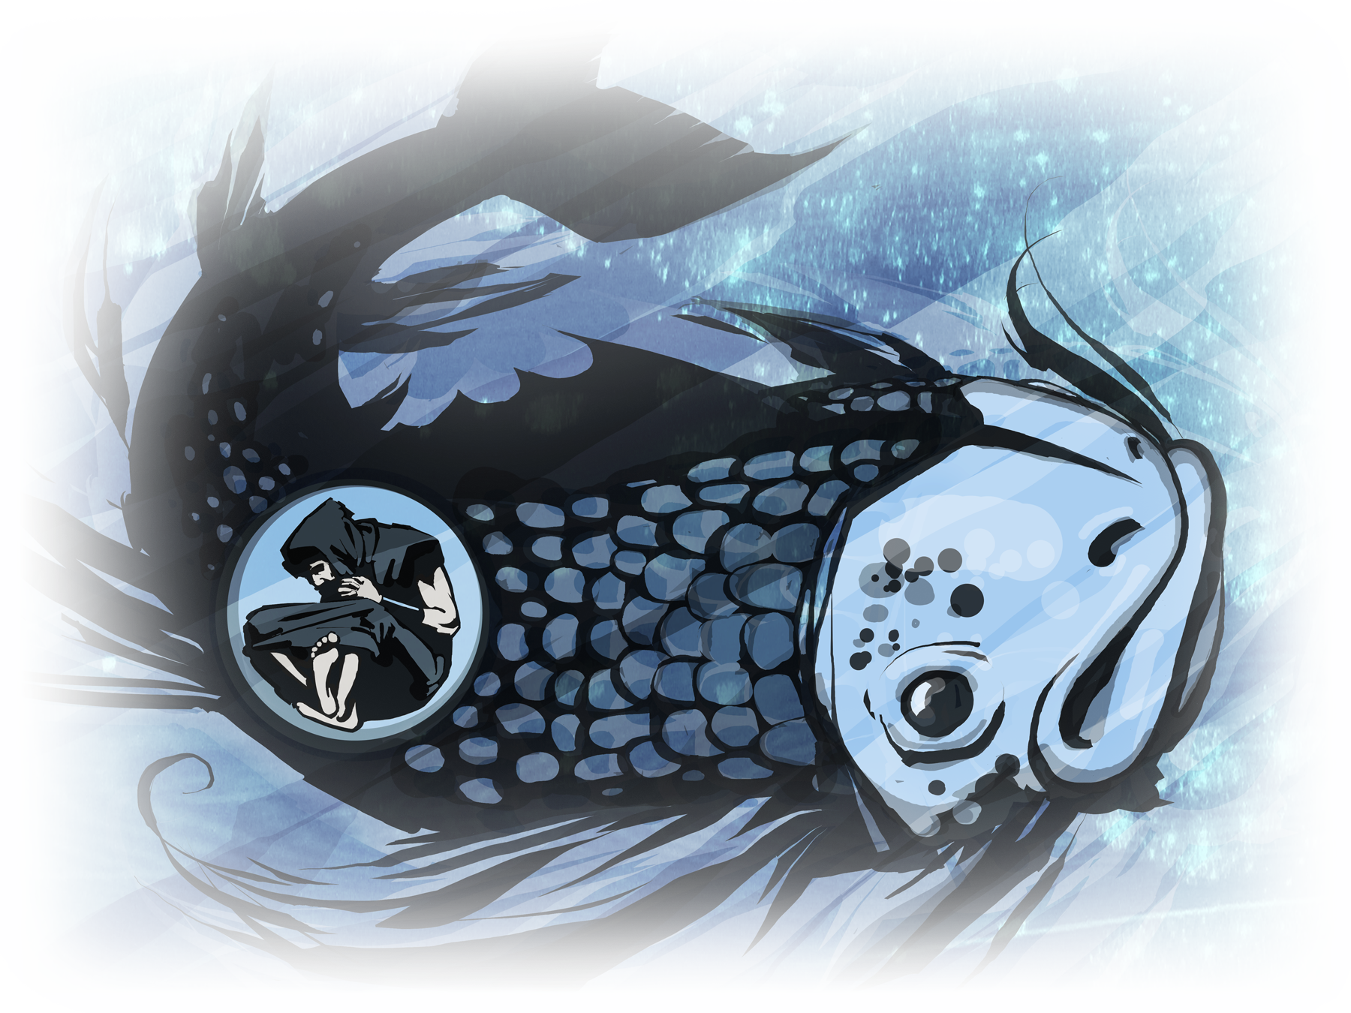
The Messiah Will Rise
弥赛亚会复活
“For as Jonah was three days and three nights in the belly of a huge fish, so the Son of Man will be three days and three nights in the heart of the earth.” (Matthew 12:40)
“约拿三日三夜在大鱼肚腹中，人子也要这样三日三夜在地里头。”（太12:40）

Slide 5
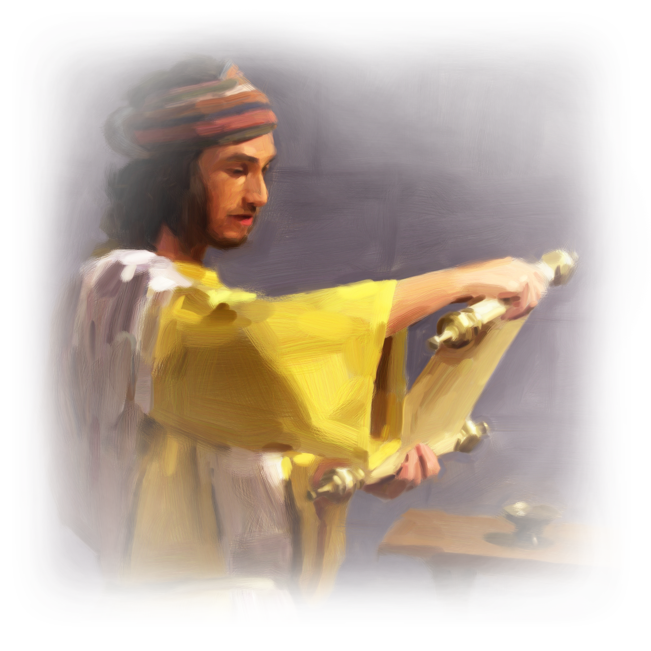
The Messiah Will Rise
弥赛亚会复活
“I know that my Redeemer lives … (Job 19:25-27)
“我知道我的救赎主活着……”（伯19:25-27）

Slide 6
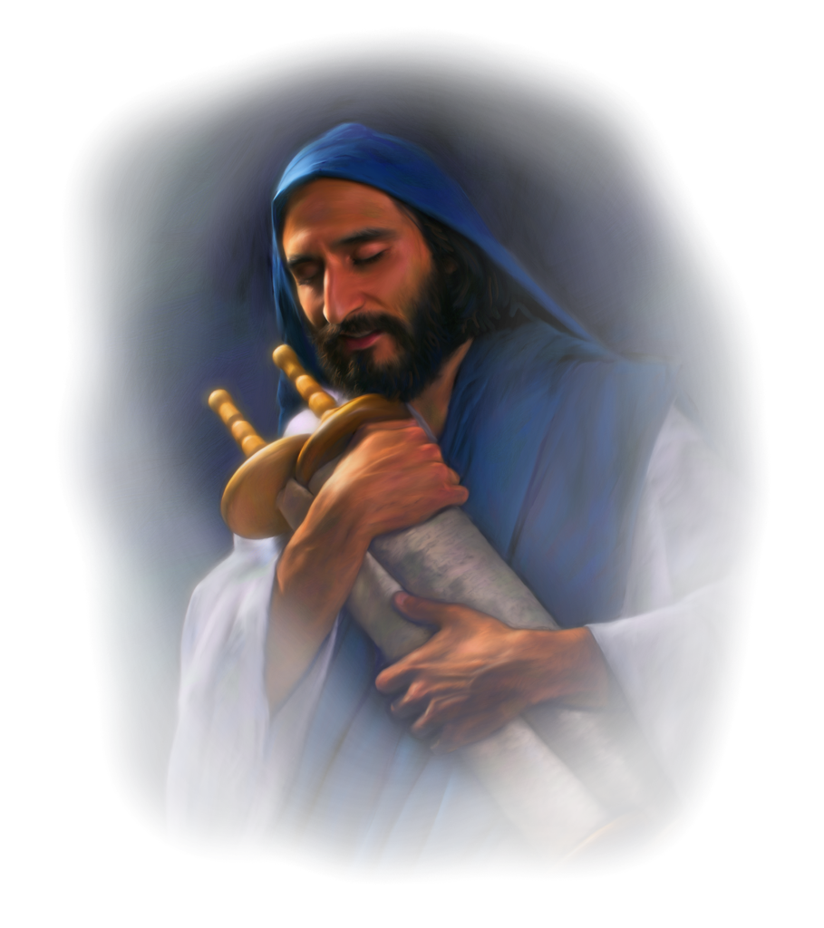
The Messiah Will Rise
弥赛亚会复活
Psalm 16
诗16

Slide 7
A miktam of David.大卫的金诗
Is this David or Jesus speaking?说这话的是大卫还是耶稣？
PSALM 16:10 “Therefore my heart is glad and my tongue rejoices; my body also will rest secure, because you will not abandon me to the grave, nor will you let your Holy One see decay.” 诗16:10 “因为你必不将我的灵魂撇在阴间。也不叫你的圣者见朽坏。” | Acts 2:22–32 (NIV84) David said about him: “Therefore my heart is glad and my tongue rejoices; my body also will live in hope, because you will not abandon me to the grave, nor will you let your Holy One see decay.” “Brothers, I can tell you confidently that the patriarch David died and was buried, and his tomb is here to this day. But he was a prophet and knew that God had promised him on oath that he would place one of his descendants on his throne. Seeing what was ahead, he spoke of the resurrection of the Christ, that he was not abandoned to the grave, nor did his body see decay. God has raised this Jesus to life, and we are all witnesses of the fact. 徒2:22-32 以色列人哪，请听我的话。神借着拿撒勒人耶稣，在你们中间施行异能，奇事，神迹，将他证明出来，这是你们自己知道的。他既按着神的定旨先见，被交与人，你们就借着无法之人的手，把他钉在十字架上杀了。神却将死的痛苦解释了，叫他复活。因为他原不能被死拘禁。大卫指着他说，我看见主常在我眼前，他在我右边，叫我不至于摇动。所以我心里欢喜，我的灵快乐。并且我的肉身要安居在指望中。因你必不将我的灵魂撇在阴间，也不叫你的圣者见朽坏。你已将生命的道路指示我，必叫我因见你的面，得着满足的快乐。弟兄们，先祖大卫的事，我可以明明地对你们说，他死了，也葬埋了，并且他的坟墓，直到今日还在我们这里。大卫既是先知，又晓得神曾向他起誓，要从他的后裔中，立一位坐在他的宝座上。就预先看明这事，讲论基督复活说，他的灵魂，不撇在阴间，他的肉身，也不见朽坏。这耶稣，神已经叫他复活了，我们都为这事作见证。

Slide 8
A miktam of David.大卫的金诗
Is this David or Jesus speaking? 说这话的是大卫还是耶稣？
PSALM 16:10 “nor will you let your Holy One see decay.” 诗16:10 “也不叫你的圣者见朽坏” | Acts 13:35–37 (NIV84) ³⁵ So it is stated elsewhere: “‘You will not let your Holy One see decay.’ ³⁶ “For when David had served God’s purpose in his own generation, he fell asleep; he was buried with his fathers and his body decayed. ³⁷ But the one whom God raised from the dead did not see decay. 徒13:35-37 ³⁵又有一篇上说，你必不叫你的圣者见朽坏。³⁶大卫在世的时候，遵行了神的旨意，就睡了。归到他祖宗那里，已见朽坏。³⁷惟独神所复活的，他并未见朽坏。

Slide 9
PART 1
第一部分
JESUS’ PERFECT OBEDIENCE AND
SUBMISSION TO THE FATHER’S WILL
耶稣完全顺服父的旨意
Psalm 16:1-4
诗16:1-4

Slide 10
PSALM 16:1-2
诗16:1-2
¹ Keep me safe, O God, for in you I take refuge. ² I said to the Lord, “You are my Lord; apart from you I have no good thing.”
1神阿，求你保佑我，因为我投靠你。2我的心哪，你曾对耶和华说，你是我的主。我的好处不在你以外。

Slide 11
PSALM 16:1-2
诗16:1-2
¹ Keep me safe, O God, for in you I take refuge. ² I said to the Lord, “You are my Lord; apart from you I have no good thing.”
1神阿，求你保佑我，因为我投靠你。2我的心哪，你曾对耶和华说，你是我的主。我的好处不在你以外。
“Father, into your hands I commit my spirit.” When he had said this, he breathed his last.” (Luke 23:46)
“耶稣大声喊着说，父阿，我将我的灵魂交在你手里。说了这话，气就断了。”（路23:46）

Slide 12
诗16:1-2
¹ Keep me safe, O God, for in you I take refuge. ² I said to the Lord, “You are my Lord; apart from you I have no good thing.”
1神阿，求你保佑我，因为我投靠你。2我的心哪，你曾对耶和华说，你是我的主。我的好处不在你以外。
“When they hurled their insults at him, he did not retaliate; when he suffered, he made no threats. Instead, he entrusted himself to him who judges justly.” (1 Peter 2:23)
“他被骂不还口。受害不说威吓的话。只将自己交托那按公义审判人的主。”（彼前2:23）
“So then, those who suffer according to God’s will should commit themselves to their faithful Creator and continue to do good.” (1 Peter 4:19)
“所以那照神旨意受苦的人，要一心为善，将自己灵魂交与那信实的造化之主。”（彼前4:19）

Slide 13
诗16:1-2
¹ Keep me safe, O God, for in you I take refuge. ² I said to the Lord, “You are my Lord; apart from you I have no good thing.”
1神阿，求你保佑我，因为我投靠你。2我的心哪，你曾对耶和华说，你是我的主。我的好处不在你以外。
Is this saying that all our blessings come from God?
这是不是说，我们所有的福分都是从神而来？
b. Is this saying that nothing I do is good unless it is done for the glory of God?
这是不是说，我所行的善只有为荣耀神而行的才算为善？

Slide 14
诗16:1-2
¹ Keep me safe, O God, for in you I take refuge. ² I said to the Lord, “You are my Lord; apart from you I have no good thing.”
1神阿，求你保佑我，因为我投靠你。2我的心哪，你曾对耶和华说，你是我的主。我的好处不在你以外。
“Every good and perfect gift is from above, coming down from the Father of the heavenly lights, who does not change like shifting shadows.” (James 1:17)
“各样美善的恩赐，和各样全备的赏赐，都是从上头来的。从众光之父那里降下来的。在他并没有改变，也没有转动的影儿。”（雅1:17）
b. “Praise God from whom all blessings flow.”
赞美上帝，所有的祝福都从他而来。
c. “Not my will, but Yours be done. Lord, Your will for my life is always best.”
不是我的意思，而是你的意思。主啊，你对我生命的旨意永远是最好的。

Slide 15
PSALM 16:3
诗16:3
³ As for the saints who are in the land, they are the glorious ones in whom is all my delight.
论到世上的圣民，他们又美又善，是我最喜悦的。

Slide 16
PSALM 16:3
诗16:3
³ As for the saints who are in the land, they are the glorious ones in whom is all my delight.
论到世上的圣民，他们又美又善，是我最喜悦的。
They are the recipients of glorious grace.
他们是美善恩典的接受者。
b. They do everything for the glory of God.
他们做一切事情都是为了神的荣耀。
c. They have their identity in Christ, who is glorious.
他们在基督里有位分，而基督是又美又善的。

Slide 17
PSALM 16:3
诗16:3
³ As for the saints who are in the land, they are the glorious ones in whom is all my delight.
论到世上的圣民，他们又美又善，是我最喜悦的。

Slide 18
PSALM 16:4
诗16:4
⁴ The sorrows of those will increase who run after other gods. I will not pour out their libations of blood or take up their names on my lips.
以别神代替耶和华的，他们的愁苦必加增。他们所浇奠的血我不献上，我嘴唇也不提别神的名号。

Slide 19
PSALM 16:4
诗16:4
⁴ The sorrows of those will increase who run after other gods. I will not pour out their libations of blood or take up their names on my lips.
以别神代替耶和华的，他们的愁苦必加增。他们所浇奠的血我不献上，我嘴唇也不提别神的名号
“And you took your sons and daughters whom you bore to me and sacrificed them as food to the idols. Was your prostitution not enough? You slaughtered my children and sacrificed them to the idols.” (Ezekiel 16:20–21).
“并且你将给我所生的儿女焚献给他。你行淫乱岂是小事，竟将我的儿女杀了，使他们经火归与他吗？”(结16:20-21)

Slide 20
PSALM 16:4
诗16:4
⁴ The sorrows of those will increase who run after other gods. I will not pour out their libations of blood or take up their names on my lips.
以别神代替耶和华的，他们的愁苦必加增。他们所浇奠的血我不献上，我嘴唇也不提别神的名号。

Slide 21
PART 2
第二部分
JESUS EXPRESSES CONFIDENCE
IN THE FUTURE
耶稣对未来满怀信心
Psalm 16:5-6
诗16：5-6

Slide 22
PSALM 16:5
诗16:5
⁵ Lord, you have assigned me my portion and my cup; you have made my lot secure.
耶和华是我的产业，是我杯中的分。我所得的你为我持守。

Slide 23
PSALM 16:5
诗16:5
⁵ Lord, you have assigned me my portion and my cup; you have made my lot secure.
耶和华是我的产业，是我杯中的分。我所得的你为我持守。
“Put your sword away! Shall I not drink the cup the Father has given me?” (John 18:11)
“收刀入鞘吧。我父所给我的那杯，我岂可不喝呢？” （约18:11）
“He went away a second time and prayed, “My Father, if it is not possible for this cup to be taken away unless I drink it, may your will be done.” (Matthew 26:42)
“第二次又去祷告说，我父阿，这杯若不能离开我，必要我喝，就愿你的意旨成全。”（太26:42）

Slide 24
诗16:5
⁵ Lord, you have assigned me my portion and my cup; you have made my lot secure.
耶和华是我的产业，是我杯中的分。我所得的你为我持守。
“Therefore I will give him a portion among the great, and he will divide the spoils with the strong, because he poured out his life unto death, and was numbered with the transgressors. For he bore the sin of many, and made intercession for the transgressors.” (Isaiah 53:12)
“所以我要使他与位大的同分，与强盛的均分掳物。因为他将命倾倒，以致于死。他也被列在罪犯之中。他却担当多人的罪，又为罪犯代求。”（赛53：12）

Slide 25
诗16:5
⁵ Lord, you have assigned me my portion and my cup; you have made my lot secure.
耶和华是我的产业，是我杯中的分。我所得的你为我持守。
4) Lot = an allotted share or portion: (“to receive one's lot of an inheritance”).
所得的=分配的份额或部分（得到某人的遗产份额）
5) Lot = the portion in life assigned by fate or Providence; one's fate, fortune, or destiny: (“Her lot had not been a happy one.”)
所得的=命运或神所赋予人生的部分；一个人的命运、运势或命定（她的命运并不幸福）

Slide 26
PSALM 16:6
诗16:6
⁶ The boundary lines have fallen for me in pleasant places; surely I have a delightful inheritance.
用绳量给我的地界，坐落在佳美之处。我的产业实在美好。

Slide 27
PSALM 16:6
诗16:6
⁶ The boundary lines have fallen for me in pleasant places; surely I have a delightful inheritance.
用绳量给我的地界，坐落在佳美之处。我的产业实在美好。
“But when the tenants saw the son, they said to each other, ‘This is the heir. Come, let’s kill him and take his inheritance.’” (Matthew 21:38)
“不料，园户看见他儿子，就彼此说，这是承受产业的。来吧，我们杀他，占他的产业。”（太21:38）

Slide 28
PSALM 16:6
诗16:6
⁶ The boundary lines have fallen for me in pleasant places; surely I have a delightful inheritance.
用绳量给我的地界，坐落在佳美之处。我的产业实在美好。
“Praise be to the God and Father of our Lord Jesus Christ! In his great mercy he has given us new birth into a living hope through the resurrection of Jesus Christ from the dead, and into an inheritance that can never perish, spoil or fade—kept in heaven for you,” (1 Peter 1:3–4)
“愿颂赞归与我们主耶稣基督的父神，他曾照自己的大怜悯，借耶稣基督从死里复活重生了我们，叫我们有活泼的盼望，可以得着不能朽坏，不能玷污，不能衰残，为你们存留在天上的基业。”（彼前1:3-4）

Slide 29
PART 3
第三部分
JESUS’ CONFIDENCE THAT
THE LORD IS WITH HIM
耶稣相信耶和华与他同在
Psalm 16:7-8
诗16:7-8

Slide 30
PSALM 16:7
诗16:7
⁷ I will praise the Lord, who counsels me; even at night my heart instructs me.
我必称颂那指教我的耶和华。我的心肠在夜间也警戒我。
“For I did not speak of my own accord, but the Father who sent me commanded me what to say and how to say it. I know that his command leads to eternal life. So whatever I say is just what the Father has told me to say.” (John 12:49–50)
“因为我没有凭着自己讲。惟有差我来的父，已经给我命令，叫我说什么，讲什么。我也知道他的命令就是永生。故此我所讲的话，正是照着父对我所说的。”（约12:49-50）

Slide 31
PSALM 16:7
诗16:7
⁷ I will praise the Lord, who counsels me; even at night my heart instructs me.
我必称颂那指教我的耶和华。我的心肠在夜间也警戒我。

Slide 32
PSALM 16:7
诗16:7
⁷ I will praise the Lord, who counsels me; even at night my heart instructs me.
我必称颂那指教我的耶和华。我的心肠在夜间也警戒我。
“But these are written that you may believe that Jesus is the Christ, the Son of God, and that by believing you may have life in his name.” (John 20:31)
“但记这些事，要叫你们信耶稣是基督，是神的儿子。并且叫你们信了他，就可以因他的名得生命。”（约20:31）

Slide 33
PSALM 16:8
诗16:8
⁸ I have set the Lord always before me. Because he is at my right hand, I will not be shaken.
我将耶和华常摆在我面前。因他在我右边，我便不至摇动。

Slide 34
PSALM 16:8
诗16:8
⁸ I have set the Lord always before me. Because he is at my right hand, I will not be shaken.
我将耶和华常摆在我面前。因他在我右边，我便不至摇动。

Slide 35
PART 4
第四部分
JESUS WILL RISE FROM THE DEAD AND LIVE FOREVER
耶稣会从死里复活并且永远活着
Psalm 16:9-11
诗16:9-11

Slide 36
PSALM 16:9-10
诗16:9-10
⁹ Therefore my heart is glad and my tongue rejoices; my body also will rest secure, ¹⁰ because you will not abandon me to the grave, nor will you let your Holy One see decay.
因此我的心欢喜，我的灵快乐。我的肉身也要安然居住。因为你必不将我的灵魂撇在阴间。也不叫你的圣者见朽坏。
“Simon Peter answered him, “Lord, to whom shall we go? You have the words of eternal life. We believe and know that you are the Holy One of God.” (John 6:68–69)
“西门彼得回答说，主阿，你有永生之道，我们还归从谁呢？我们已经信了，又知道你是神的圣者。”（约6:68-69）

Slide 37
诗16:9-10
⁹ Therefore my heart is glad and my tongue rejoices; my body also will rest secure, ¹⁰ because you will not abandon me to the grave, nor will you let your Holy One see decay.
因此我的心欢喜，我的灵快乐。我的肉身也要安然居住。因为你必不将我的灵魂撇在阴间。也不叫你的圣者见朽坏。
“We are going up to Jerusalem, and everything that is written by the prophets about the Son of Man will be fulfilled. He will be handed over to the Gentiles. They will mock him, insult him, spit on him, flog him and kill him. On the third day he will rise again.” (Luke 18:31–33)
“我们上耶路撒冷去，先知所写的一切事，都要成就在人子身上。他将要被交给外邦人，他们要戏弄他，凌辱他，吐唾沫在他脸上。并要鞭打他，杀害他，第三日他要复活。”（路18:31-33）

Slide 38
PSALM 16:11
诗16:11
¹¹ You have made known to me the path of life; you will fill me with joy in your presence, with eternal pleasures at your right hand.
你必将生命的道路指示我。在你面前有满足的喜乐。在你右手中有永远的福乐。
“In the way of righteousness there is life; along that path is immortality.” (Proverbs 12:28)
“在公义的道上有生命。其路之中，并无死亡。”（箴12:28）

Slide 39
PSALM 16:11
诗16:11
¹¹ You have made known to me the path of life; you will fill me with joy in your presence, with eternal pleasures at your right hand.
你必将生命的道路指示我。在你面前有满足的喜乐。在你右手中有永远的福乐。
“Surely you have granted him eternal blessings and made him glad with the joy of your presence.” (Psalm 21:6)
“你的手要搜出你的一切仇敌。你的右手要搜出那些恨你的人。”（诗21:6）

Slide 40
20) What do we now know about the Messiah?
现在我们知道关于弥赛亚的什么信息？
We learn that the Messiah was trusting in the Father to keep him safely when he would travel through the valley of the shadow of death.
我们知道，弥赛亚相信在他经过死阴幽谷之时，父会保守他的安全。
We learn that the Messiah was confident that God’s plan for him to suffer and die and rise again would be carried out successfully.
我们知道，弥赛亚相信关于他受苦受死并且复活的神的计划会成功。
We learn that the Messiah would follow God’s will and plan, even if it meant spending a time in the grave, for he would rise from the dead.
我们知道，弥赛亚会遵行神的旨意和计划，哪怕他会在坟墓中待一段时间，因为他还会从死里复活。

