Slide 1
Welcome to Bible Class
欢迎参加圣经课程
The Messiah in the Old Testament
旧约中的弥赛亚

Slide 2
第二部分Part 2
THE MESSIAH IN THE PROPHETS
先知书中的弥赛亚
Lesson 5 = The Messiah in Isaiah Part 1
第五课=以赛亚书中的弥赛亚 第一部分
Lesson 6 = The Messiah in Isaiah Part 2
第六课=以赛亚书中的弥赛亚 第二部分
Lesson 7 = The Messiah In the Major Prophets
第七课=大先知书中的弥赛亚
Lesson 8 = The Messiah in the Minor Prophets
第八课=小先知书中的弥赛亚

Slide 3
1. Jeremiah 23:5-6 = The Lord our Righteousness
耶23:5-6=耶和华我们的义
2. Jeremiah 30:9,21 = The Messiah as the priestly king
耶30:9,21=弥赛亚是君尊的祭司
3. Jeremiah 31:15 = The massacre of infants
耶31:15=婴儿被屠杀
4. Jeremiah 33:15-16 = The Lord Our Righteousness
耶33:15-16=耶和华我们的义
5. Ezekiel 17:22-24 = The Messiah as the tender sprig
结17:22-24=弥赛亚是嫩枝
6. Ezekiel 21:25-27 = The Messiah as the rightful king
结21:25-27=弥赛亚是公义的君王
7. Ezekiel 34:11-16, 23, 24 = The Messiah as Good Shepherd
结34:11-16,23,24=弥赛亚是好牧人
8. Ezekiel 37:15-28 = The Messiah as the great unifier of nations
结37:15-28=弥赛亚使万国合一
9. Daniel 7:13-14 = The Son of Man
但7:13-14=人子
10. Daniel 9:24-27 = The Messiah as anointed ruler
但9:24-27=弥赛亚是受膏的君王

Slide 4
THE LORD
OUR RIGHTEOUSNESS
耶和华我们的义
Jeremiah 23:5-6
耶23:5-6

Slide 5
Jeremiah 23:5-6
“The days are coming,” declares the LORD, “when I will raise up to David a righteous Branch, a King who will reign wisely and do what is just and right in the land. In his days Judah will be saved and Israel will live in safety. This is the name by which he will be called: The LORD Our Righteousness.”
耶23:5-6
“耶和华说，日子将到，我要给大卫兴起一个公义的苗裔。他必掌王权，行事有智慧，在地上施行公平和公义。在他的日子，犹大必得救，以色列也安然居住。他的名必称为耶和华我们的义。”

Slide 6
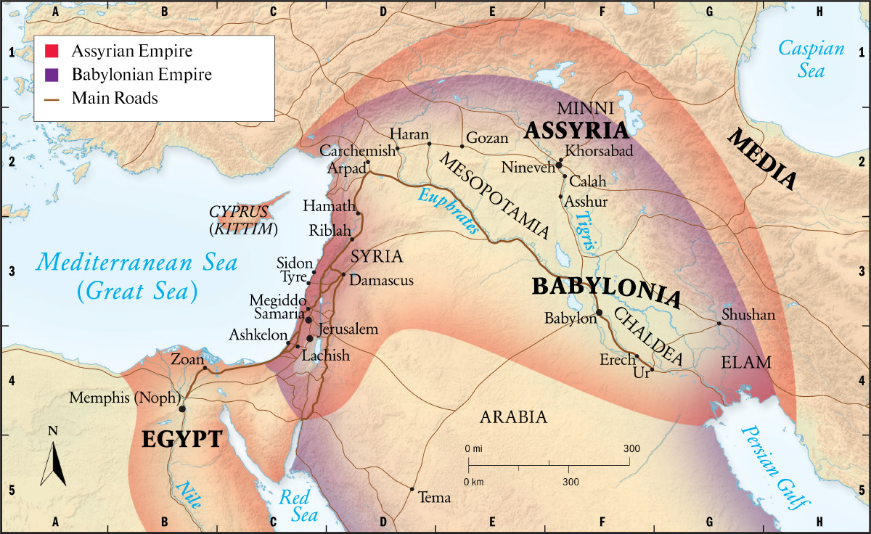
JEREMIAH 23:5-6
586 BC
公元前586

Slide 7
Similar Prophecies in Jeremiah 耶利米书中的相似预言
Jeremiah 23:5-6 耶23:5-6 | Jeremiah 33:15-16 耶33:15-16
“The days are coming,” declares the LORD, “when I will raise up to David a righteous Branch, 耶和华说，日子将到，我要给大卫兴起一个公义的苗裔。 a King who will reign wisely and do what is just and right in the land. 他必掌王权，行事有智慧，在地上施行公平和公义。 In his days Judah will be saved and Israel will live in safety. 在他的日子，犹大必得救，以色列也安然居住。 This is the name by which he will be called: The LORD Our Righteousness.” 他的名必称为耶和华我们的义。 | “In those days and at that time I will make a righteous Branch sprout from David’s line; 当那日子，那时候，我必使大卫公义的苗裔长起来。 he will do what is just and right in the land. 他必在地上施行公平和公义。 In those days Judah will be saved and Jerusalem will live in safety. 在那日子犹大必得救，耶路撒冷必安然居住， This is the name by which it will be called: The LORD Our Righteousness.” 他的名必称为耶和华我们的义。

Slide 8
Jeremiah 23:5-6
The days are coming,” declares the LORD, “when I will raise up to David a righteous Branch, a King who will reign wisely and do what is just and right in the land. In his days Judah will be saved and Israel will live in safety. This is the name by which he will be called: The LORD Our Righteousness.”
耶23:5-6
“耶和华说，日子将到，我要给大卫兴起一个公义的苗裔。他必掌王权，行事有智慧，在地上施行公平和公义。在他的日子，犹大必得救，以色列也安然居住。他的名必称为耶和华我们的义。”
“Concerning this salvation, the prophets, who spoke of the grace that was to come to you, searched intently and with the greatest care, trying to find out the time and circumstances to which the Spirit of Christ in them was pointing when he predicted the sufferings of Christ and the glories that would follow.” (1 Peter 1:10–11)
“论到这救恩，那预先说你们要得恩典的众先知，早已详细的寻求考察。
就是考察在他们心里基督的灵，预先证明基督受苦难，后来得荣耀，是指着什么时候，并怎样的时候。”（彼前1:10-11）

Slide 9
Jeremiah 23:5-6
The days are coming,” declares the LORD, “when I will raise up to David a righteous Branch, a King who will reign wisely and do what is just and right in the land. In his days Judah will be saved and Israel will live in safety. This is the name by which he will be called: The LORD Our Righteousness.”
耶23:5-6
“耶和华说，日子将到，我要给大卫兴起一个公义的苗裔。他必掌王权，行事有智慧，在地上施行公平和公义。在他的日子，犹大必得救，以色列也安然居住。他的名必称为耶和华我们的义。”
“The time is coming,” declares the LORD, “when I will make a new covenant with the house of Israel and with the house of Judah … For I will forgive their wickedness and will remember their sins no more.” (Jeremiah 31:31, 34)
“耶和华说，日子将到，我要与以色列家和犹大家另立新约……我要赦免他们的罪孽，不再记念他们的罪恶。”（耶31:31,34）

Slide 10
Jeremiah 23:5-6
“The days are coming,” declares the LORD, “when I will raise up to David a righteous Branch, a King who will reign wisely and do what is just and right in the land. In his days Judah will be saved and Israel will live in safety. This is the name by which he will be called: The LORD Our Righteousness.”
耶23:5-6
“耶和华说，日子将到，我要给大卫兴起一个公义的苗裔。他必掌王权，行事有智慧，在地上施行公平和公义。在他的日子，犹大必得救，以色列也安然居住。他的名必称为耶和华我们的义。”
“In that day the Branch of the LORD will be beautiful and glorious, and the fruit of the land will be the pride and glory of the survivors in Israel.” (Isaiah 4:2)
“A shoot will come up from the stump of Jesse; from his roots a Branch will bear fruit.” (Isaiah 11:1)
“到那日，耶和华发生的苗，必华美尊荣，地的出产，必为以色列逃脱的人显为荣华茂盛。”（赛4:2）
“从耶西的本必发一条，从他根生的枝子必结果实。”（赛11:1）

Slide 11
Jeremiah 23:5-6
“The days are coming,” declares the LORD, “when I will raise up to David a righteous Branch, a King who will reign wisely and do what is just and right in the land. In his days Judah will be saved and Israel will live in safety. This is the name by which he will be called: The LORD Our Righteousness.”
耶23:5-6
“耶和华说，日子将到，我要给大卫兴起一个公义的苗裔。他必掌王权，行事有智慧，在地上施行公平和公义。在他的日子，犹大必得救，以色列也安然居住。他的名必称为耶和华我们的义。”
“Listen, O high priest Joshua and your associates seated before you, who are men symbolic of things to come: I am going to bring my servant, the Branch.” (Zechariah 3:8)
“Tell him this is what the LORD Almighty says: ‘Here is the man whose name is the Branch, and he will branch out from his place and build the temple of the LORD.” (Zechariah 6:12)
“大祭司约书亚阿，你和坐在你面前的同伴都当听。我必使我仆人大卫的苗裔发出。”（亚3:8）
“对他说，万军之耶和华如此说，看哪，那名称为大卫苗裔的，他要在本处长起来。并要建造耶和华的殿。”（亚6:12）

Slide 12
Jeremiah 23:5-6
“The days are coming,” declares the LORD, “when I will raise up to David a righteous Branch, a King who will reign wisely and do what is just and right in the land. In his days Judah will be saved and Israel will live in safety. This is the name by which he will be called: The LORD Our Righteousness.”
耶23:5-6
“耶和华说，日子将到，我要给大卫兴起一个公义的苗裔。他必掌王权，行事有智慧，在地上施行公平和公义。在他的日子，犹大必得救，以色列也安然居住。他的名必称为耶和华我们的义。”
“A record of the genealogy of Jesus Christ the son of David” (Matthew 1:1).
“亚伯拉罕的后裔，大卫的子孙，耶稣基督的家谱。”（太1:1）

Slide 13
Jeremiah 23:5-6
“The days are coming,” declares the LORD, “when I will raise up to David a righteous Branch, a King who will reign wisely and do what is just and right in the land. In his days Judah will be saved and Israel will live in safety. This is the name by which he will be called: The LORD Our Righteousness.”
耶23:5-6
“耶和华说，日子将到，我要给大卫兴起一个公义的苗裔。他必掌王权，行事有智慧，在地上施行公平和公义。在他的日子，犹大必得救，以色列也安然居住。他的名必称为耶和华我们的义。”

Slide 14
JEREMIAH 23:5-6
耶23:5-6
“Anyone who lives on milk, being still an infant, is not acquainted with the teaching about righteousness. But solid food is for the mature, who by constant use have trained themselves to distinguish good from evil.” (Hebrews 5:13–14)
“凡只能吃奶的，都不熟练仁义的道理。因为他是婴孩。惟独长大成人的，才能吃干粮，他们的心窍，习练得通达，就能分辨好歹了。”（来5:13-14）

Slide 15
JEREMIAH 23:5-6
耶23:5-6
“righteous”
“公义的”
“to be right, guiltless, correct, without fault, flawless, holy.”
“对的，无罪的，正确的，没有过错的，没有缺陷的，圣洁的”

Slide 16
JEREMIAH 23:5-6
耶23:5-6
5) Name some people, other than Jesus, who are “righteous”.
请举出“义”人的名字，除了耶稣？

Slide 17
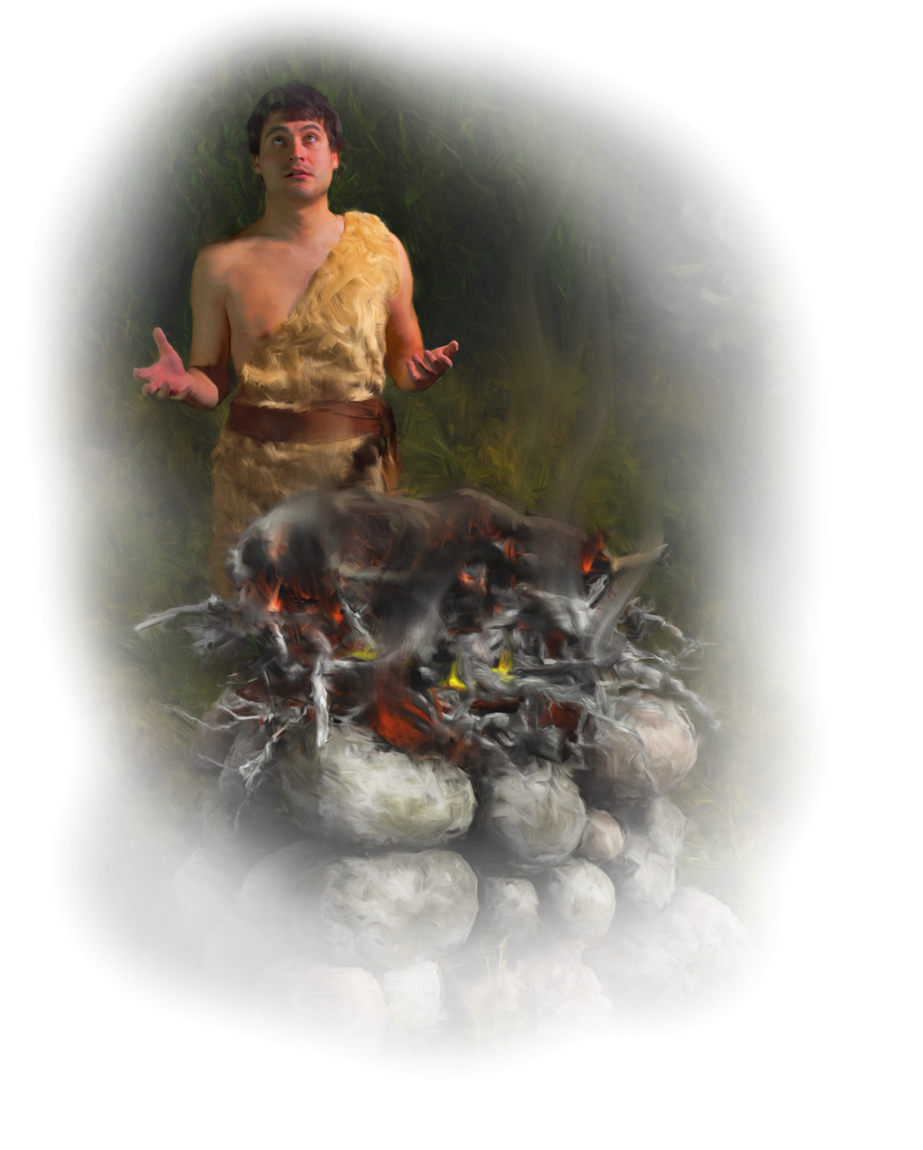
JEREMIAH 23:5-6
耶23:5-6
Abel
Hebrews 11:4 - “By faith Abel offered God a better sacrifice than Cain did. By faith he was commended as a righteous man, when God spoke well of his offerings.”
亚伯
来11:4 – “亚伯因着信献祭与神，比该隐所献的更美，因此便得了称义的见证，就是神指他礼物作的见证。”

Slide 18
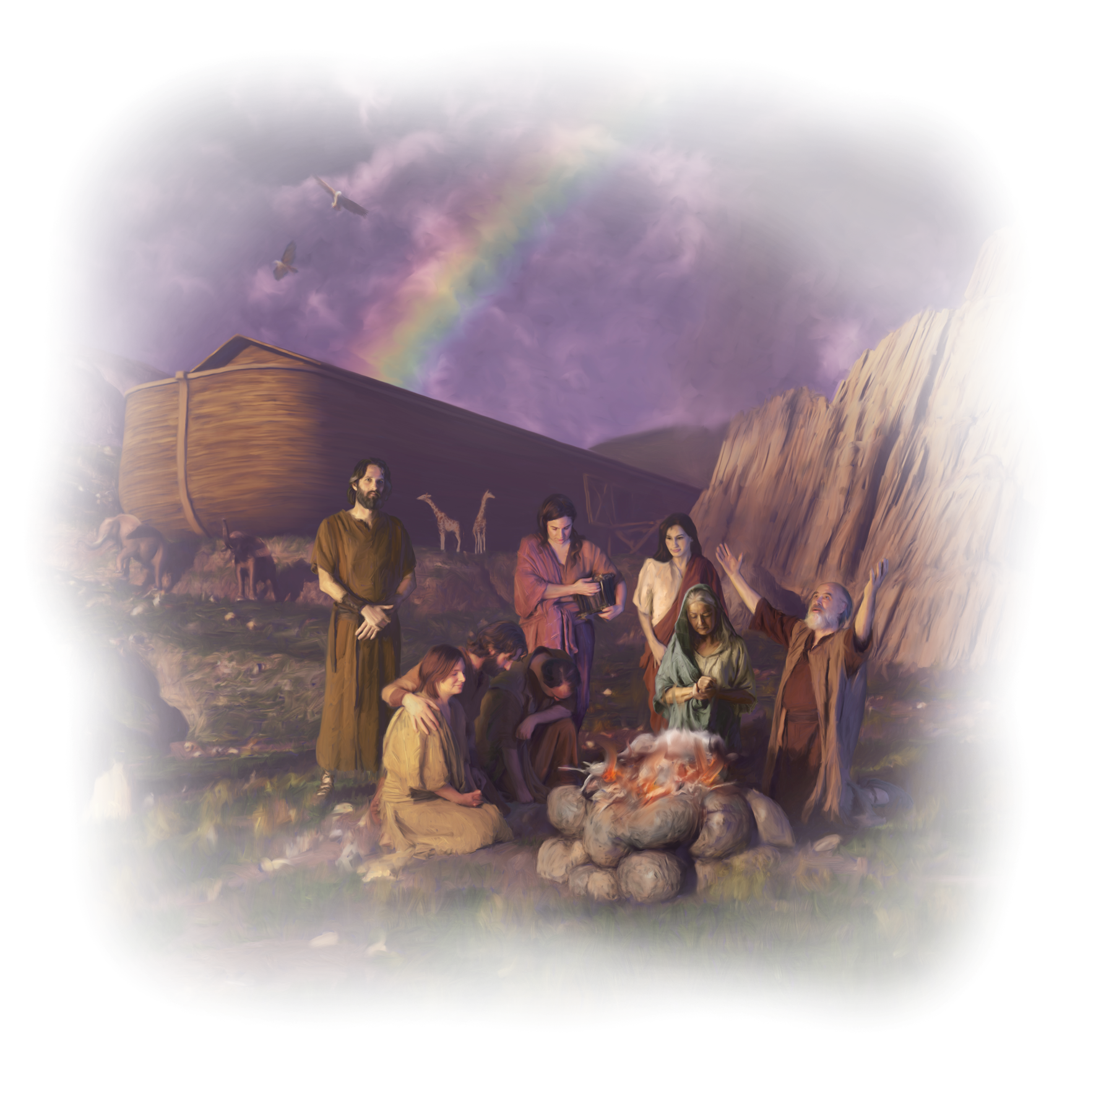
JEREMIAH 23:5-6
耶23:5-6
Noah
Genesis 6:9 - “Noah was a righteous man, blameless among the people of his time, and he walked with God.”
诺亚
创6:9 – “挪亚是个义人，在当时的世代是个完全人。挪亚与神同行。”

Slide 19
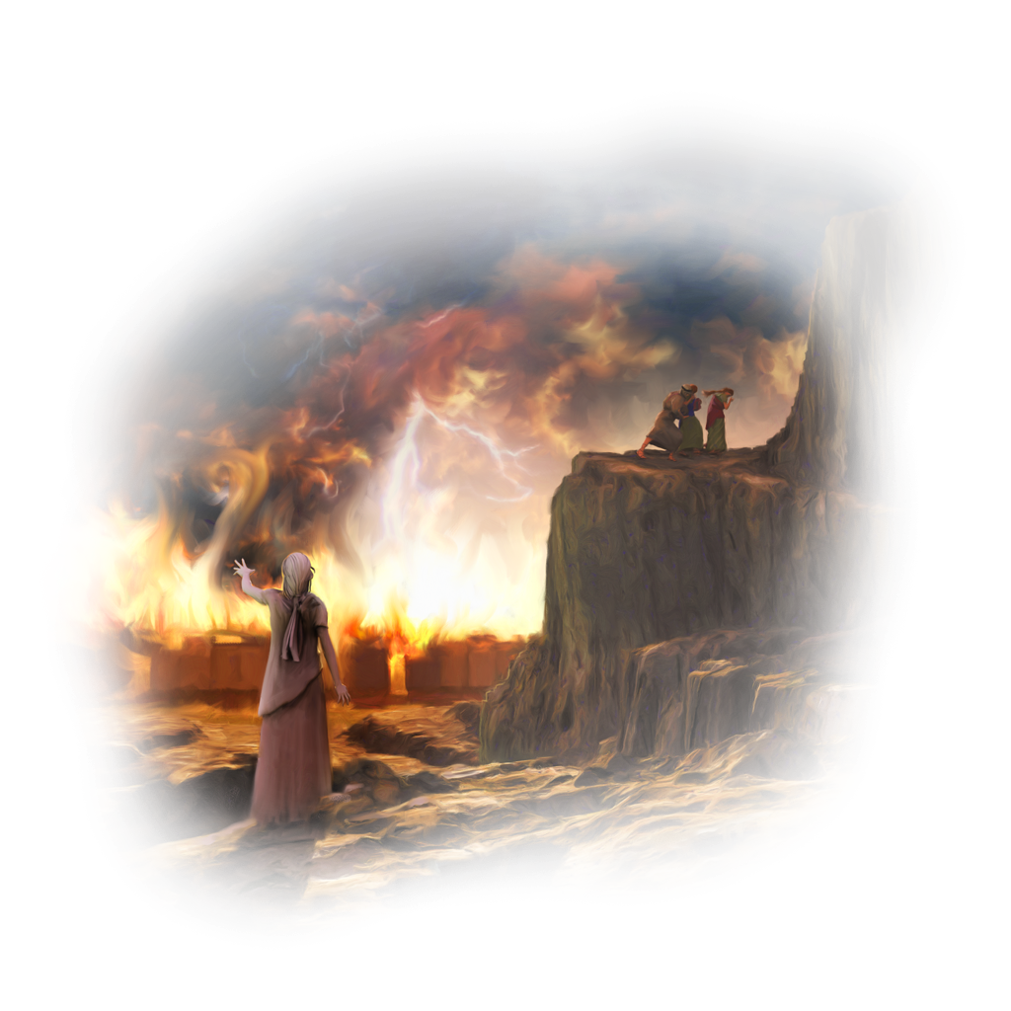
JEREMIAH 23:5-6
耶23:5-6
Lot
2 Peter 2:7 - “he rescued Lot, a righteous man, who was distressed by the filthy lives of lawless men”
罗得
彼后2:7 – “只搭救了那常为恶人淫行忧伤的义人罗得。”

Slide 20
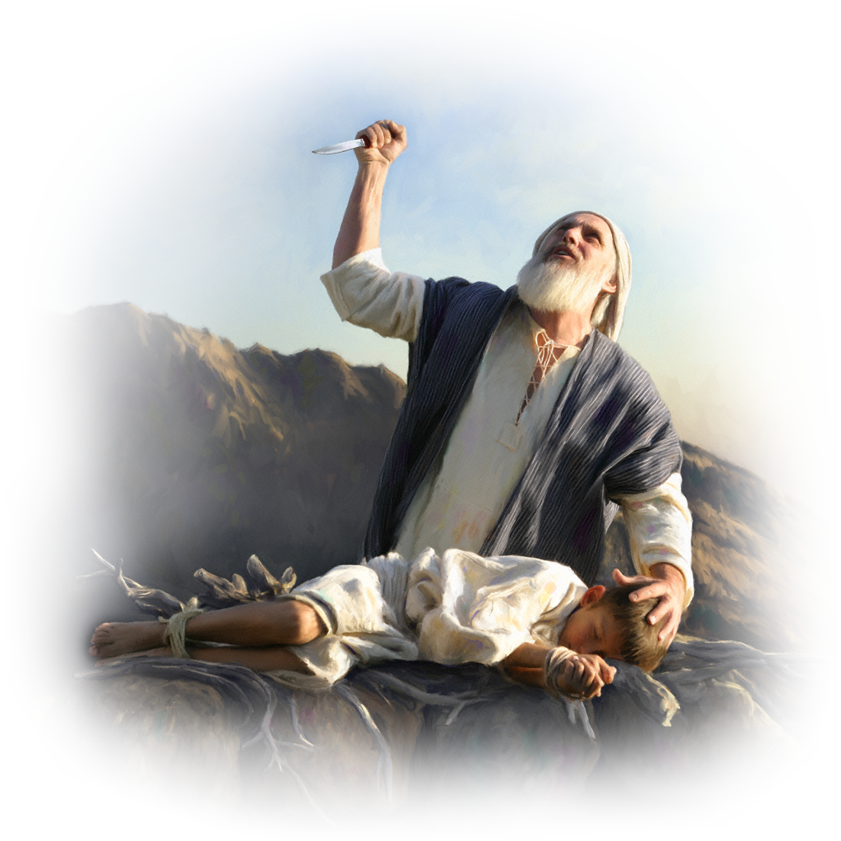
JEREMIAH 23:5-6
耶23:5-6
Abraham
James 2:21 - “Was not our ancestor Abraham considered righteous for what he did when he offered his son Isaac on the altar?”
亚伯拉罕
雅2:21 – “我们的祖宗亚伯拉罕，把他儿子以撒献在坛上，岂不是因行为称义吗？”

Slide 21
JEREMIAH 23:5-6
耶23:5-6
Rahab
James 2:25 - “In the same way, was not even Rahab the prostitute considered righteous for what she did when she gave lodging to the spies?”
喇合
雅2:25 – “妓女喇合接待使者，又放他们从别的路上出去，不也是一样因行为称义吗？”

Slide 22
JEREMIAH 23:5-6
耶23:5-6
David
1 Kings 3:6 - “You have shown great kindness to your servant, my father David, because he was faithful to you and righteous and upright in heart.”
大卫
王上3:6 – “所罗门说，你仆人我父亲大卫用诚实，公义，正直的心行在你面前，你就向他大施恩典”

Slide 23
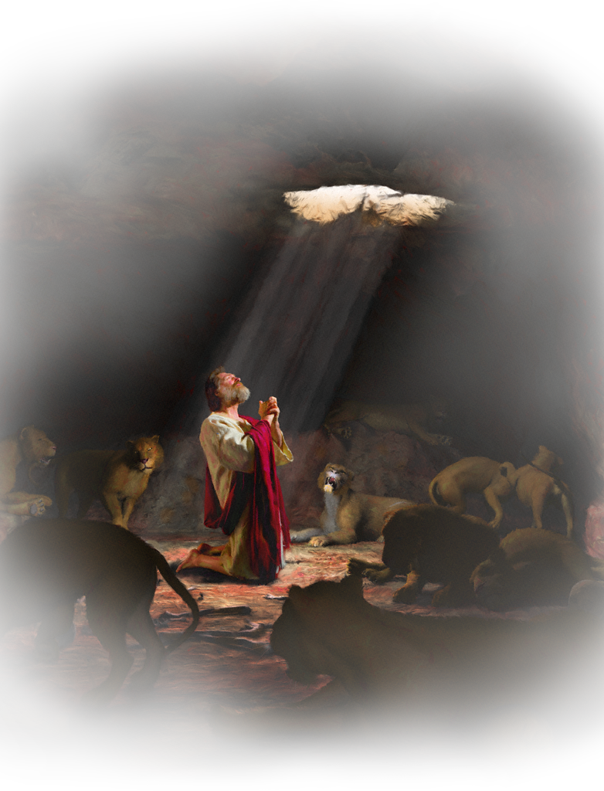
JEREMIAH 23:5-6
耶23:5-6
Noah, Daniel, and Job
Ezekiel 14:14 - “even if these three men—Noah, Daniel and Job—were in it, they could save only themselves by their righteousness, declares the Sovereign LORD.”
诺亚，但以理和约伯
结14:14 – “其中虽有挪亚，但以理，约伯这三人，他们只能因他们的义救自己的性命。这是主耶和华说的。”

Slide 24
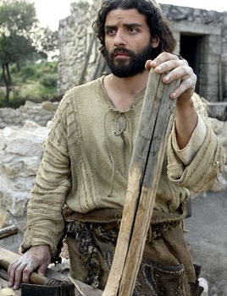
JEREMIAH 23:5-6
耶23:5-6
Joseph
Matthew 1:19 - “Joseph her husband was a righteous man …”
约瑟
太1:19 – “她丈夫约瑟是个义人”

Slide 25
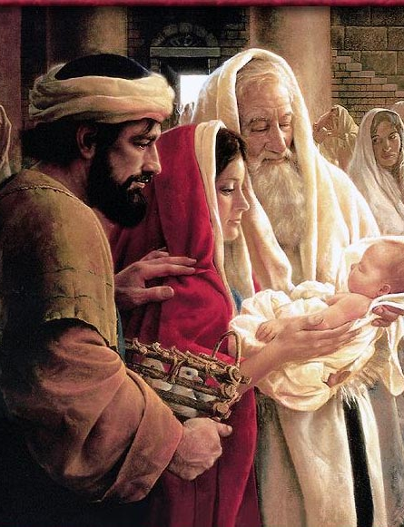
JEREMIAH 23:5-6
耶23:5-6
Simeon
Luke 2:25 - “Now there was a man in Jerusalem called Simeon, who was righteous and devout.”
西面
路2:25 – “在耶路撒冷有一个人名叫西面，这人又公义又虔诚”

Slide 26
Cornelius
Acts 10:22 - “The men replied, “We have come from Cornelius the centurion. He is a righteous and God-fearing man, who is respected by all the Jewish people.”
哥尼流
徒10:22 – “他们说，百夫长哥尼流是个义人，敬畏神，为犹太通国所称赞”

Slide 27
JEREMIAH 23:5-6
耶23:5-6
God’s People
Psalm 118:15 - “Shouts of joy and victory resound in the tents of the righteous.”
神的子民
诗118:15 – “在义人的帐棚里，有欢呼拯救的声音。”

Slide 28
JEREMIAH 23:5-6
耶23:5-6
“Surely I was sinful at birth, sinful from the time my mother conceived me.” (Psalm 51:5)
“我是在罪孽里生的。在我母亲怀胎的时候，就有了罪。”（诗51:5）

Slide 29
JEREMIAH 23:5-6
耶23:5-6
“Do not bring your servant into judgment, for no one living is righteous before you.” (Psalm 143:2)
“求你不要审问仆人。因为在你面前，凡活着的人，没有一个是义的。”（诗143:2）

Slide 30
JEREMIAH 23:5-6
耶23:5-6
“How then can a man be righteous before God? How can one born of woman be pure?” (Job 25:4)
“这样在神面前，人怎能称义？妇人所生的怎能洁净？”（伯25:4）

Slide 31
JEREMIAH 23:5-6
“There is not a righteous man on earth who does what is right and never sins.” (Ecclesiastes 7:20)
“时常行善而不犯罪的义人，世上实在没有。”（传7:20）

Slide 32
JEREMIAH 23:5-6
耶23:5-6
“All of us have become like one who is unclean, and all our righteous acts are like filthy rags; we all shrivel up like a leaf, and like the wind our sins sweep us away.”
(Isaiah 64:6)
“我们都像不洁净的人，所有的义都像污秽的衣服。我们都像叶子渐渐枯干。我们的罪孽好像风把我们吹去。”（赛64:6）

Slide 33
JEREMIAH 23:5-6
耶23:5-6
“As it is written: “There is no one righteous, not even one;” (Romans 3:10)
“就如经上所记，没有义人，连一个也没有。”（罗3:10）

Slide 34
JEREMIAH 23:5-6
耶23:5-6
“for all have sinned and fall short of the glory of God,” (Romans 3:23)
“因为世人都犯了罪，亏缺了神的荣耀。”（罗3:23）

Slide 35
JEREMIAH 23:5-6
耶23:5-6
“By faith Abel offered God a better sacrifice than Cain did. By faith he was commended as a righteous man, when God spoke well of his offerings.” (Hebrews 11:4)
“亚伯因着信献祭与神，比该隐所献的更美，因此便得了称义的见证，就是神指他礼物作的见证。他虽然死了，却因这信仍旧说话。”（来11:4）

Slide 36
JEREMIAH 23:5-6
耶23:5-6
“By faith Noah, when warned about things not yet seen, in holy fear built an ark to save his family. By his faith he condemned the world and became heir of the righteousness that comes by faith.” (Hebrews 11:7)
“挪亚因着信，既蒙神指示他未见的事，动了敬畏的心，预备了一只方舟，使他全家得救。因此就定了那世代的罪，自己也承受了那从信而来的义。”（来11:7）

Slide 37
JEREMIAH 23:5-6
耶23:5-6
Consider Abraham: “He believed God, and it was credited to him as righteousness.” (Galatians 3:6)
正如，亚伯拉罕信神，这就算为他的义。（加3:6）

Slide 38
JEREMIAH 23:5-6
耶23:5-6
“By faith the prostitute Rahab, because she welcomed the spies, was not killed with those who were disobedient.” (Hebrews 11:31)
“妓女喇合因着信，曾和和平平的接待探子，就不与那些不顺从的人一同灭亡。”（来11:31）

Slide 39
JEREMIAH 23:5-6
耶23:5-6
“David says the same thing when he speaks of the blessedness of the man to whom God credits righteousness apart from works:” (Romans 4:6)
“正如大卫称那在行为以外，蒙神算为义的人是有福的。”（罗4:6）

Slide 40
JEREMIAH 23:5-6
耶23:5-6
“the righteous will live by his faith.” (Habakkuk 2:4)
“惟义人因信得生。”（哈2:4）

Slide 41
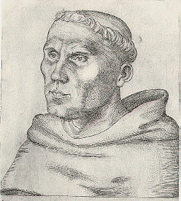
Dr. Martin Luther
“I hated that word ‘righteousness of God’”
我厌恶“神的义”这个词

Slide 42
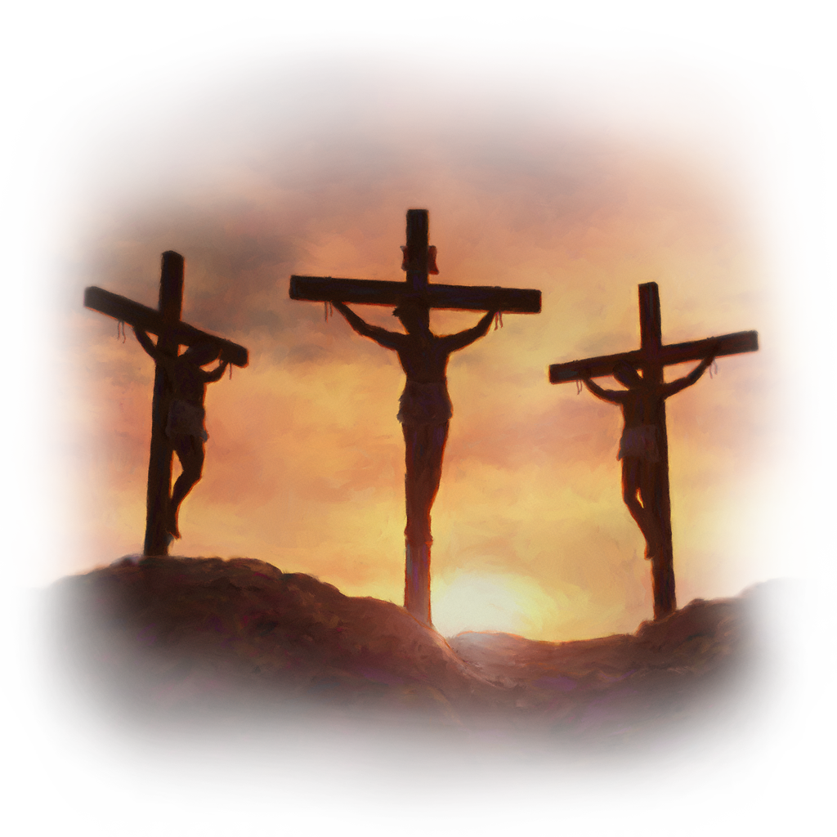
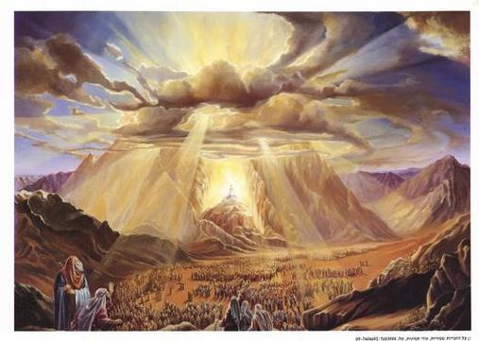
RIGHTEOUSNESS
义
Law
律法
Gospel
福音

Slide 43
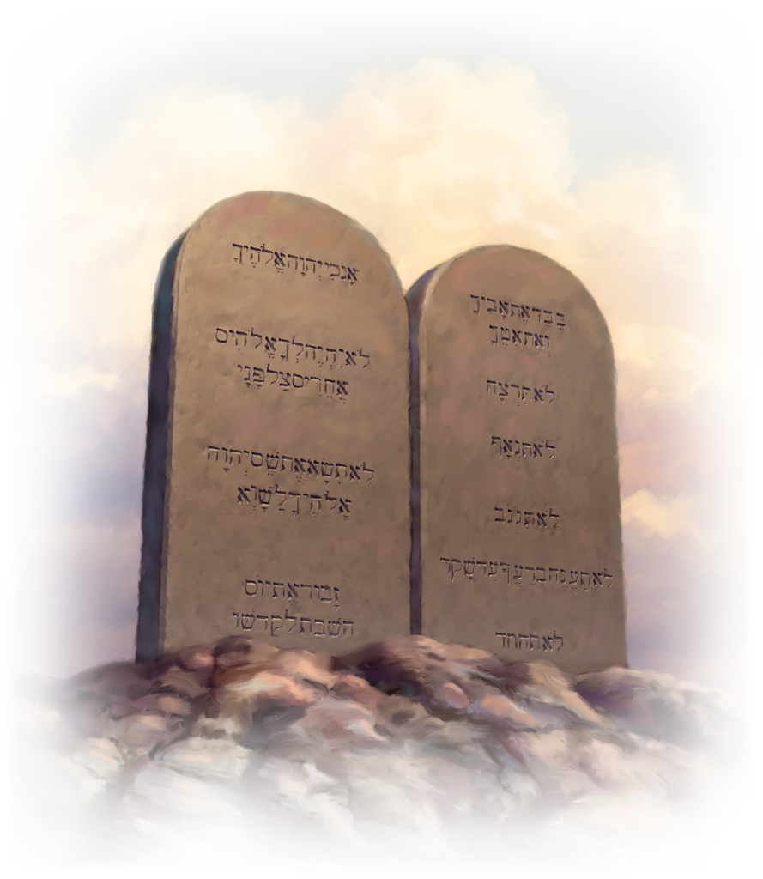
Law
律法
“And if we are careful to obey all this law before the LORD our God, as he has commanded us, that will be our righteousness.” (Deuteronomy 6:25)
“我们若照耶和华我们神所吩咐的一切诫命谨守遵行，这就是我们的义了。”（申6:25）

Slide 44
Law
律法
“The wages of the righteous bring them life, but the income of the wicked brings them punishment.” (Proverbs 10:16)
“义人的勤劳致生。恶人的进项致死。”（箴10:16）
“The truly righteous man attains life, but he who pursues evil goes to his death.” (Proverbs 11:19)
“恒心为义的，必得生命。追求邪恶的，必致死亡。”（箴11:19）
“Suppose there is a righteous man who does what is just and right. He follows my decrees and faithfully keeps my laws. That man is righteous; he will surely live, declares the Sovereign LORD.” (Ezekiel 18:5,9)
“人若是公义，且行正直与合理的事，遵行我的律例，谨守我的典章，按诚实行事这人是公义的，必定存活。这是主耶和华说的。”（结18:5,9）

Slide 45
Law
律法
“The man who does these things will live by them.” (Romans 10:5)
“人若行那出于律法的义，就必因此活着。”（罗10:5）

Slide 46
LAW “righteousness” 律法的“义”
God’s demand that we live holy lives, perfectly obeying his commandments, or we will be subject to his eternal punishment: “Be perfect, therefore, as your heavenly Father is perfect.” (Matthew 5:48)
神要求我们过圣洁的生活，完全遵行他的诫命，否则我们就要领受永恒的惩罚：“所以你们要完全，象你们的天父完全一样。”（太5:48）

Slide 47
LAW “righteousness” 律法的“义”
“as for legalistic righteousness, [I was] faultless. But whatever was to my profit I now consider loss for the sake of Christ. What is more, I consider everything a loss compared to the surpassing greatness of knowing Christ Jesus my Lord, for whose sake I have lost all things. I consider them rubbish, that I may gain Christ and be found in him, not having a righteousness of my own that comes from the law, but that which is through faith in Christ—the righteousness that comes from God and is by faith.” (Philippians 3:6–9)
“就热心说，我是逼迫教会的。就律法上的义说，我是无可指摘的。只是我先前以为与我有益的，我现在因基督都当作有损的。不但如此，我也将万事当作有损的，因我以认识我主基督耶稣为至宝。我为他已经丢弃万事，看作粪土，为要得着基督。并且得以在他里面，不是有自己因律法而得的义，乃是有信基督的义，就是因信神而来的义。”（腓3:6-9）

Slide 48
LAW “righteousness”
律法的“义”
“I do not set aside the grace of God, for if righteousness could be gained through the law, Christ died for nothing!” (Galatians 2:21)
“我不废掉神的恩。义若是借着律法得的，基督就是徒然死了。”（加2:21）
“Clearly no one is justified before God by the law, because, “The righteous will live by faith.” (Galatians 3:11)
“没有一个人靠着律法在神面前称义，这是明显的。因为经上说，义人必因信得生。”（加3:11）

Slide 49
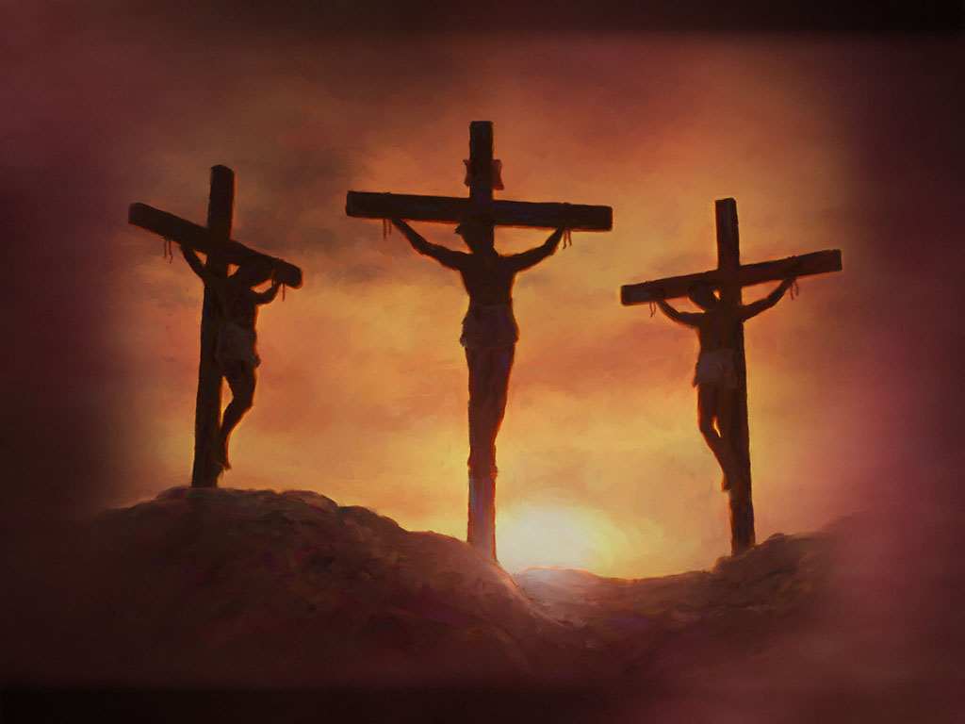
GOSPEL righteousness
福音的义
“But now a righteousness from God, apart from law, has been made known, to which the Law and the Prophets testify.” (Romans 3:21)
“但如今神的义在律法以外已经显明出来，有律法和先知为证。”（罗3:21）

Slide 50
“What does the Scripture say? “Abraham believed God, and it was credited to him as righteousness.” (Romans 4:3)
“经上说什么呢？说，亚伯拉罕信神，这就算为他的义。” （罗4:3）
“David says the same thing when he speaks of the blessedness of the man to whom God credits righteousness apart from works: “Blessed are they whose transgressions are forgiven, whose sins are covered.” (Romans 4:6–7)
“正如大卫称那在行为以外，蒙神算为义的人是有福的。他说，得赦免其过，遮盖其罪的，这人是有福的。”（罗4:6-7）
GOSPEL
righteousness
福音的义

Slide 51
“Christ is the end of the law so that there may be righteousness for everyone who believes.” (Romans 10:4)
“律法的总结就是基督，使凡信他的都得着义。”（罗10:4）
“What then shall we say? That the Gentiles, who did not pursue righteousness, have obtained it, a righteousness that is by faith;” (Romans 9:30)
“这样，我们可说什么呢？那本来不追求义的外邦人，反得了义，就是因信而得的义。”（罗9:30）
GOSPEL
righteousness
福音的义

Slide 52
Jeremiah 23:5-6
“The days are coming,” declares the LORD, “when I will raise up to David a righteous Branch, a King who will reign wisely and do what is just and right in the land. In his days Judah will be saved and Israel will live in safety. This is the name by which he will be called: The LORD Our Righteousness.”
耶23:5-6
“耶和华说，日子将到，我要给大卫兴起一个公义的苗裔。他必掌王权，行事有智慧，在地上施行公平和公义。在他的日子，犹大必得救，以色列也安然居住。他的名必称为耶和华我们的义。”

Slide 53
Jeremiah 23:5-6
“The days are coming,” declares the LORD, “when I will raise up to David a righteous Branch, a King who will reign wisely and do what is just and right in the land. In his days Judah will be saved and Israel will live in safety. This is the name by which he will be called: The LORD Our Righteousness.”
耶23:5-6
“耶和华说，日子将到，我要给大卫兴起一个公义的苗裔。他必掌王权，行事有智慧，在地上施行公平和公义。在他的日子，犹大必得救，以色列也安然居住。他的名必称为耶和华我们的义。”
“You disowned the Holy and Righteous One and asked that a murderer be released to you.” (Acts 3:14)
“你们弃绝了那圣洁公义者，反求着释放一个凶手给你们。”（徒3:14）

Slide 54
Jeremiah 23:5-6
“The days are coming,” declares the LORD, “when I will raise up to David a righteous Branch, a King who will reign wisely and do what is just and right in the land. In his days Judah will be saved and Israel will live in safety. This is the name by which he will be called: The LORD Our Righteousness.”
耶23:5-6
“耶和华说，日子将到，我要给大卫兴起一个公义的苗裔。他必掌王权，行事有智慧，在地上施行公平和公义。在他的日子，犹大必得救，以色列也安然居住。他的名必称为耶和华我们的义。”
“Was there ever a prophet your fathers did not persecute? They even killed those who predicted the coming of the Righteous One. And now you have betrayed and murdered him” (Acts 7:52)
“那一个先知，不是你们祖宗逼迫呢？他们也把预先传说那义者要来的人杀了。如今你们又把那义者卖了，杀了。”(徒 7:52)

Slide 55
Jeremiah 23:5-6
“The days are coming,” declares the LORD, “when I will raise up to David a righteous Branch, a King who will reign wisely and do what is just and right in the land. In his days Judah will be saved and Israel will live in safety. This is the name by which he will be called: The LORD Our Righteousness.”
耶23:5-6
“耶和华说，日子将到，我要给大卫兴起一个公义的苗裔。他必掌王权，行事有智慧，在地上施行公平和公义。在他的日子，犹大必得救，以色列也安然居住。他的名必称为耶和华我们的义。”
“The God of our fathers has chosen you to know his will and to see the Righteous One and to hear words from his mouth.” (Acts 22:14)
“他又说，我们祖宗的神，拣选了你，叫你明白他的旨意，又得见那义者，听他口中所出的声音。” (徒 22:14)

Slide 56
“But if anybody does sin, we have one who speaks to the Father in our defense—Jesus Christ, the Righteous One.” (1 John 2:1)
Jeremiah 23:5-6
“The days are coming,” declares the LORD, “when I will raise up to David a righteous Branch, a King who will reign wisely and do what is just and right in the land. In his days Judah will be saved and Israel will live in safety. This is the name by which he will be called: The LORD Our Righteousness.”
耶23:5-6
“耶和华说，日子将到，我要给大卫兴起一个公义的苗裔。他必掌王权，行事有智慧，在地上施行公平和公义。在他的日子，犹大必得救，以色列也安然居住。他的名必称为耶和华我们的义。”
“若有人犯罪，在父那里我们有一位中保，就是那义者耶稣基督”(约一 2:1)

Slide 57
Jeremiah 23:5-6
“The days are coming,” declares the LORD, “when I will raise up to David a righteous Branch, a King who will reign wisely and do what is just and right in the land. In his days Judah will be saved and Israel will live in safety. This is the name by which he will be called: The LORD Our Righteousness.”
耶23:5-6
“耶和华说，日子将到，我要给大卫兴起一个公义的苗裔。他必掌王权，行事有智慧，在地上施行公平和公义。在他的日子，犹大必得救，以色列也安然居住。他的名必称为耶和华我们的义。”
“Surely this was a righteous man.” (Luke 23:47)
“这真是个义人。”（路23:47）

Slide 58
Jeremiah 23:5-6
“The days are coming,” declares the LORD, “when I will raise up to David a righteous Branch, a King who will reign wisely and do what is just and right in the land. In his days Judah will be saved and Israel will live in safety. This is the name by which he will be called: The LORD Our Righteousness.”
耶23:5-6
“耶和华说，日子将到，我要给大卫兴起一个公义的苗裔。他必掌王权，行事有智慧，在地上施行公平和公义。在他的日子，犹大必得救，以色列也安然居住。他的名必称为耶和华我们的义。”

Slide 59
Jeremiah 23:5-6
“The days are coming,” declares the LORD, “when I will raise up to David a righteous Branch, a King who will reign wisely and do what is just and right in the land. In his days Judah will be saved and Israel will live in safety. This is the name by which he will be called: The LORD Our Righteousness.”
耶23:5-6
“耶和华说，日子将到，我要给大卫兴起一个公义的苗裔。他必掌王权，行事有智慧，在地上施行公平和公义。在他的日子，犹大必得救，以色列也安然居住。他的名必称为耶和华我们的义。”
“Christ Jesus has become for us wisdom from God—that is, our righteousness, holiness and redemption.” (1 Corinthians 1:30)
“God made him who had no sin to be sin for us, so that in him we might become the righteousness of God.” (2 Corinthians 5:21)
“但你们得在基督耶稣里，是本乎神，神又使他成为我们的智慧，公义，圣洁，救赎。” (林前1:30)
“神使那无罪的（无罪原文作不知罪），替我们成为罪。好叫我们在他里面成为神的义。” (林后5:21)

Slide 60
“John came to show you the way of righteousness” (Matthew 21:32)
“约翰遵着义路到你们这里来”（太21:32）
“For in the gospel a righteousness from God is revealed, a righteousness that is by faith from first to last, just as it is written: “The righteous will live by faith.” (Romans 1:17)
“因为神的义，正在这福音上显明出来。这义是本于信以致于信。如经上所记，义人必因信得生。”（罗1:17）

Slide 61
13) What do we now know about the Messiah?
关于弥赛亚，现在我们知道些什么？
We know that the Messiah will be God himself. God will come to us.
我们知道，弥赛亚就是神自己。神会在我们中间。
We know that the Messiah will be righteous and will provide the righteousness that is needed for salvation.
我们知道弥赛亚是义，并且会赐给我们得救所需的义。
We were also reminded that he will be a royal descendant of David.
经文也提醒我们，他乃是大卫皇室的后裔。

Slide 62
THE SON OF MAN
人子
Daniel 7:13-14
但7:13-14

Slide 63
Daniel 7:13-14
“In my vision at night I looked, and there before me was one like a son of man, coming with the clouds of heaven. He approached the Ancient of Days and was led into his presence. He was given authority, glory and sovereign power; all peoples, nations and men of every language worshiped him. His dominion is an everlasting dominion that will not pass away, and his kingdom is one that will never be destroyed.”
但7:13-14
“我在夜间的异象中观看，见有一位像人子的，驾着天云而来，被领到亘古常在者面前，得了权柄，荣耀，国度，使各方，各国，各族的人都事奉他。他的权柄是永远的，不能废去。他的国必不败坏。”

Slide 64
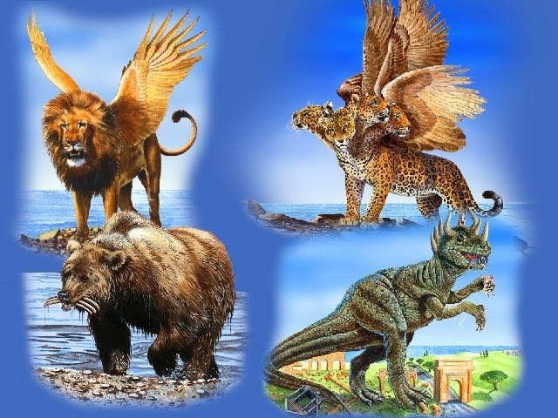

Slide 65
Daniel 7:13-14 “In my vision at night I looked, and there before me was one like a son of man, coming with the clouds of heaven. He approached the Ancient of Days and was led into his presence. He was given authority, glory and sovereign power; all peoples, nations and men of every language worshiped him. His dominion is an everlasting dominion that will not pass away, and his kingdom is one that will never be destroyed.”
但7:13-14 “我在夜间的异象中观看，见有一位像人子的，驾着天云而来，被领到亘古常在者面前，得了权柄，荣耀，国度，使各方，各国，各族的人都事奉他。他的权柄是永远的，不能废去。他的国必不败坏。”
“As I looked, “thrones were set in place, and the Ancient of Days took his seat. His clothing was as white as snow; the hair of his head was white like wool. His throne was flaming with fire, and its wheels were all ablaze.” (Daniel 7:9)
“我观看，见有宝座设立，上头坐着亘古常在者。他的衣服洁白如雪，头发如纯净的羊毛。宝座乃火焰，其轮乃烈火。”（但7:9）
“the Ancient of Days came and pronounced judgment in favor of the saints of the Most High, and the time came when they possessed the kingdom.” (Daniel 7:22)
“直到亘古常在者来给至高者的圣民伸冤，圣民得国的时候就到了。”（但7:22）

Slide 66
Daniel 7:13-14
“In my vision at night I looked, and there before me was one like a son of man, coming with the clouds of heaven. He approached the Ancient of Days and was led into his presence. He was given authority, glory and sovereign power; all peoples, nations and men of every language worshiped him. His dominion is an everlasting dominion that will not pass away, and his kingdom is one that will never be destroyed.”
但7:13-14
“我在夜间的异象中观看，见有一位像人子的，驾着天云而来，被领到亘古常在者面前，得了权柄，荣耀，国度，使各方，各国，各族的人都事奉他。他的权柄是永远的，不能废去。他的国必不败坏。”
John 9:35-37 -- “Jesus heard that they had thrown him out, and when he found him, he said, “Do you believe in the Son of Man?” “Who is he, sir?” the man asked. “Tell me so that I may believe in him.” Jesus said, “You have now seen him; in fact, he is the one speaking with you.”
约 9:35-37—“耶稣听说他们把他赶出去。后来遇见他，就说，你信神的儿子吗？他回答说，主阿，谁是神的儿子，叫我信他呢？耶稣说，你已经看见他，现在和你说话的就是他。”

Slide 67
“one like a son of man”
“有一位像人子的”
Numbers 23:19 -- “God is not a man, that he should lie, nor a son of man, that he should change his mind.”
民23:19—“神非人，必不致说谎，也非人子，必不致后悔。”

Slide 68
Who Is the Messiah? 谁是弥赛亚
JEREMIAH 耶利米书 | DANIEL 但以理书
“the LORD” “耶和华” | “one like a son of man” “有一位像人子的”

Slide 69
Daniel 7:13-14
“In my vision at night I looked, and there before me was one like a son of man, coming with the clouds of heaven. He approached the Ancient of Days and was led into his presence. He was given authority, glory and sovereign power; all peoples, nations and men of every language worshiped him. His dominion is an everlasting dominion that will not pass away, and his kingdom is one that will never be destroyed.”
但7:13-14
“我在夜间的异象中观看，见有一位像人子的，驾着天云而来，被领到亘古常在者面前，得了权柄，荣耀，国度，使各方，各国，各族的人都事奉他。他的权柄是永远的，不能废去。他的国必不败坏。”
Matthew 24:30 - “At that time the sign of the Son of Man will appear in the sky, and all the nations of the earth will mourn. They will see the Son of Man coming on the clouds of the sky, with power and great glory.”).
太24:30 – “那时，人子的兆头要显在天上，地上的万族都要哀哭。他们要看见人子，有能力，有大荣耀，驾着天上的云降临。”

Slide 70
Daniel 7:13-14 但7:13-14 | Matthew 26:64 太26:64
“one like a son of man, coming with the clouds of heaven. He approached the Ancient of Days and was led into his presence” “有一位像人子的，驾着天云而来，被领到亘古常在者面前” | “In the future you will see the Son of Man sitting at the right hand of the Mighty One and coming on the clouds of heaven.” “后来你们要看见人子，坐在那权能者的右边，驾着天上的云降临。”

Slide 71
“Now is the time for judgment on this world; now the prince of this world will be driven out. But I, when I am lifted up from the earth, will draw all men to myself.” He said this to show the kind of death he was going to die. The crowd spoke up, “We have heard from the Law that the Christ will remain forever, so how can you say, ‘The Son of Man must be lifted up’? Who is this ‘Son of Man’?” Then Jesus told them, “You are going to have the light just a little while longer. Walk while you have the light, before darkness overtakes you. The man who walks in the dark does not know where he is going. Put your trust in the light while you have it, so that you may become sons of light.” When he had finished speaking, Jesus left and hid himself from them.” (John 12:31–36)
“现在这世界受审判。这世界的王要被赶出去。我若从地上被举起来，就要吸引万人来归我。耶稣这话原是指着自己将要怎样死说的。众人回答说，我们听见律法上有话说，基督是永存的。你怎么说，人子必须被举起来呢？这人子是谁呢？耶稣对他们说，光在你们中间，还有不多的时候，应当趁着有光行走，免得黑暗临到你们。那在黑暗里行走的，不知道往何处去。你们应当趁着有光，信从这光，使你们成为光明之子。耶稣说了这话，就离开他们，隐藏了。”（约12:31-36）

Slide 72
Daniel 7:13-14
“In my vision at night I looked, and there before me was one like a son of man, coming with the clouds of heaven. He approached the Ancient of Days and was led into his presence. He was given authority, glory and sovereign power; all peoples, nations and men of every language worshiped him. His dominion is an everlasting dominion that will not pass away, and his kingdom is one that will never be destroyed.”
但7:13-14
“我在夜间的异象中观看，见有一位像人子的，驾着天云而来，被领到亘古常在者面前，得了权柄，荣耀，国度，使各方，各国，各族的人都事奉他。他的权柄是永远的，不能废去。他的国必不败坏。”

Slide 73
Daniel’s Prophecy 但以理书的预言 | New Testament Confirmation 新约印证
“He was given authority, glory and sovereign power” “得了权柄，荣耀，国度” | “All authority in heaven and on earth has been given to me.” (Matthew 28:18) “耶稣进前来，对他们说，天上，地下所有的权柄，都赐给我了。”（太28:18）
“all peoples, nations and men of every language worshiped him” “各方，各国，各族的人都事奉他” | “Therefore God exalted him to the highest place and gave him the name that is above every name, that at the name of Jesus every knee should bow, in heaven and on earth and under the earth, and every tongue confess that Jesus Christ is Lord” (Philippians 2:9–11) “所以神将他升为至高，又赐给他那超乎万名之上的名，叫一切在天上的，地上的，和地底下的，因耶稣的名，无不屈膝，无不口称耶稣基督为主，使荣耀归与父神。”（腓2:9-11）
His dominion is an everlasting dominion that will not pass away, and his kingdom is one that will never be destroyed. 他的权柄是永远的，不能废去。他的国必不败坏 | “The Lord God will give him the throne of his father David, and he will reign over the house of Jacob forever; his kingdom will never end.” (Luke 1:32–33) “他要为大，称为至高者的儿子。主神要把他祖大卫的位给他。他要作雅各家的王，直到永远。他的国也没有穷尽。”(路1:32-33)

Slide 74
18) What do we now know about the Messiah?
关于弥赛亚，我们知道什么信息？
We affirmed that the Messiah will be a human being, the son of a human being.
我们确认，弥赛亚是人，是人的孩子。
We learn that the Messiah will come on the clouds of heaven in great glory and will be worshiped by people from all nations.
我们知道，弥赛亚会驾着天上的云、在巨大的荣耀当中降临，他会受到万国万民的敬拜。
We affirmed that the Messiah’s kingdom will be never-ending.
我们确认，弥赛亚国度没是永远的。

