Slide 1
Welcome to Bible Class
欢迎参加圣经课程
The Messiah in the Old Testament
旧约中的弥赛亚

Slide 2
第二部分Part 2
THE MESSIAH IN THE PROPHETS
先知书中的弥赛亚
Lesson 5 = The Messiah in Isaiah Part 1
第五课=以赛亚书中的弥赛亚 第一部分
Lesson 6 = The Messiah in Isaiah Part 2
第六课=以赛亚书中的弥赛亚 第二部分
Lesson 7 = The Messiah In the Major Prophets
第七课=大先知书中的弥赛亚
Lesson 8 = The Messiah in the Minor Prophets
第八课=小先知书中的弥赛亚

Slide 3
Hosea
Joel
Amos
Obadiah
Jonah
Micah
Nahum
Habakkuk
Zephaniah
Haggai
Zechariah
Malachi
何西阿书
约珥书
阿摩司书
俄巴底亚书
约拿书
弥迦书
那鸿书
哈巴谷书
西番雅书
哈该书
撒迦利亚书
玛拉基书
The “Minor” Prophets
“小”先知

Slide 4
Prophetic Perspective
先知的视角
先知的角度
基督的第一次来临
基督的第二次来临

Slide 5
Hosea 1:10-2:1 = The Messiah brings also the Gentiles into God’s family
何1:10-2:1=弥赛亚也把外邦人带入神的家
Hosea 3:4-5 = The Messiah as the second David
何3:4-5=弥赛亚是第二大卫
Hosea 11:1 = The Messiah’s flight into Egypt
何11:1=弥赛亚逃往埃及
Joel 2:28-32 = The promised Holy Spirit
珥2:28-32=应许圣灵
Amos 9:11-12 = The Messiah rules over David’s house
摩9:11-12=弥赛亚掌管大卫的家
Micah 2:12-13 = The Messiah as breaker
弥2:12-13=弥赛亚是开路者
Micah 5:2-4 = The Messiah’s Birthplace
弥5:2-4=弥赛亚的出生地
Zechariah 3:8-10 = The Messiah’s work as high priest
亚3:8-10=弥赛亚作为大祭司的工作
Zechariah 6:12-13 = The Messiah as Ruler over all nations
亚6:12-13=弥赛亚是万国的王

Slide 6
Haggai 2:6-9 = The Messiah as Desire of nations
该2:6-9=弥赛亚是万国所羡慕的
Haggai 2:21-23 = The Messiah as God’s signet ring
该2:21-23=弥赛亚是神的印戒
ZECHARIAH 9:9-10 = THE MESSIAH KING OF RIGHTEOUSNESS
亚9:9-10=弥赛亚公义的王
Zechariah 11:12-13 = The Messiah as rejected good shepherd
亚11:12-13=弥赛亚是被弃的好牧人
Zechariah 12:10 = The Messiah as the pierced one
亚12:10=弥赛亚被钉
Zechariah 13:7 = The Messiah as the stricken companion
亚13:7=弥赛亚是被打的同伴
MALACHI 3:1-4 = THE MESSIAH AS MESSENGER OF THE COVENANT
玛3:1-4=弥赛亚是立约的使者
Malachi 4:2 = The Messiah as Sun of Righteousness
玛4:2=弥赛亚是公义的日头

Slide 7
THE MESSIAH KING
Of RIGHTEOUSNESS
弥赛亚公义的王
ZECHARIAH 9:9-10
亚9:9-10

Slide 8
Zechariah 9:9-10“Rejoice greatly, O Daughter of Zion! Shout, Daughter of Jerusalem! See, your king comes to you, righteous and having salvation, gentle and riding on a donkey, on a colt, the foal of a donkey. ¹⁰ I will take away the chariots from Ephraim and the war-horses from Jerusalem, and the battle bow will be broken. He will proclaim peace to the nations. His rule will extend from sea to sea and from the River to the ends of the earth.”
亚9:9-10
“锡安的民哪，应当大大喜乐。耶路撒冷的民哪，应当欢呼。看哪，你的王来到你这里。他是公义的，并且施行拯救，谦谦和和地骑着驴，就是骑着驴的驹子。我必除灭以法莲的战车，和耶路撒冷的战马。争战的弓也必除灭。他必向列国讲和平。他的权柄必从这海管到那海，从大河管到地极。”

Slide 9
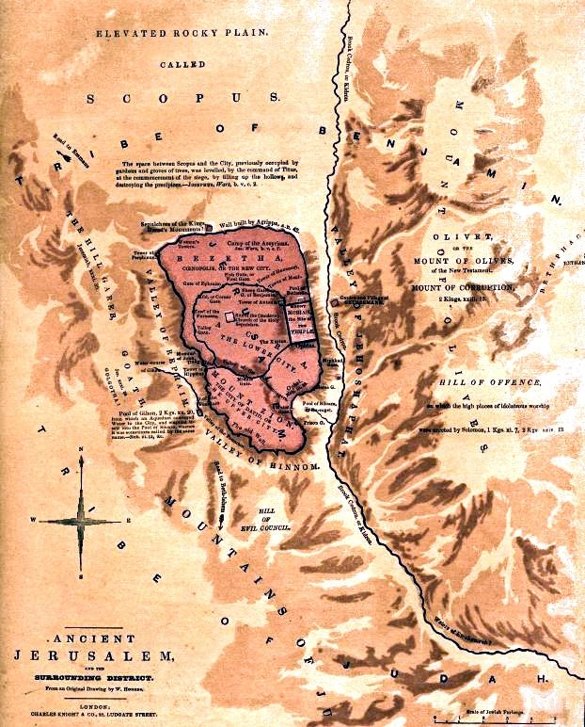
Zechariah 9:9-10 “Rejoice greatly, O Daughter of Zion! Shout, Daughter of Jerusalem! See, your king comes to you, righteous and having salvation, gentle and riding on a donkey, on a colt, the foal of a donkey. ¹⁰ I will take away the chariots from Ephraim and the war-horses from Jerusalem, and the battle bow will be broken. He will proclaim peace to the nations. His rule will extend from sea to sea and from the River to the ends of the earth.”
亚9:9-10
“锡安的民哪，应当大大喜乐。耶路撒冷的民哪，应当欢呼。看哪，你的王来到你这里。他是公义的，并且施行拯救，谦谦和和地骑着驴，就是骑着驴的驹子。我必除灭以法莲的战车，和耶路撒冷的战马。争战的弓也必除灭。他必向列国讲和平。他的权柄必从这海管到那海，从大河管到地极。”
“耶路撒冷的女子，不要为我哭，当为自己和自己的儿女哭。” (路 23:28)
“Daughters of Jerusalem, do not weep for me; weep for yourselves and for your children.” (Luke 23:28)

Slide 10
Zechariah 9:9-10 “Rejoice greatly, O Daughter of Zion! Shout, Daughter of Jerusalem! See, your king comes to you, righteous and having salvation, gentle and riding on a donkey, on a colt, the foal of a donkey. ¹⁰ I will take away the chariots from Ephraim and the war-horses from Jerusalem, and the battle bow will be broken. He will proclaim peace to the nations. His rule will extend from sea to sea and from the River to the ends of the earth.”
亚9:9-10
“锡安的民哪，应当大大喜乐。耶路撒冷的民哪，应当欢呼。看哪，你的王来到你这里。他是公义的，并且施行拯救，谦谦和和地骑着驴，就是骑着驴的驹子。我必除灭以法莲的战车，和耶路撒冷的战马。争战的弓也必除灭。他必向列国讲和平。他的权柄必从这海管到那海，从大河管到地极。”

Slide 11
Zechariah 9:9-10 “Rejoice greatly, O Daughter of Zion! Shout, Daughter of Jerusalem! See, your king comes to you, righteous and having salvation, gentle and riding on a donkey, on a colt, the foal of a donkey. ¹⁰ I will take away the chariots from Ephraim and the war-horses from Jerusalem, and the battle bow will be broken. He will proclaim peace to the nations. His rule will extend from sea to sea and from the River to the ends of the earth.”
亚9:9-10
“锡安的民哪，应当大大喜乐。耶路撒冷的民哪，应当欢呼。看哪，你的王来到你这里。他是公义的，并且施行拯救，谦谦和和地骑着驴，就是骑着驴的驹子。我必除灭以法莲的战车，和耶路撒冷的战马。争战的弓也必除灭。他必向列国讲和平。他的权柄必从这海管到那海，从大河管到地极。”
“Jesus found a young donkey and sat upon it, as it is written, “Do not be afraid, O Daughter of Zion; see, your king is coming, seated on a donkey’s colt.” (John 12:14–15)
“耶稣得了一个驴驹，就骑上。如经上所记的说，锡安的民哪，不要惧怕，你的王骑着驴驹来了。”（约12:14-15）

Slide 12
Zechariah 9:9-10 “Rejoice greatly, O Daughter of Zion! Shout, Daughter of Jerusalem! See, your king comes to you, righteous and having salvation, gentle and riding on a donkey, on a colt, the foal of a donkey. ¹⁰ I will take away the chariots from Ephraim and the war-horses from Jerusalem, and the battle bow will be broken. He will proclaim peace to the nations. His rule will extend from sea to sea and from the River to the ends of the earth.”
亚9:9-10
“锡安的民哪，应当大大喜乐。耶路撒冷的民哪，应当欢呼。看哪，你的王来到你这里。他是公义的，并且施行拯救，谦谦和和地骑着驴，就是骑着驴的驹子。我必除灭以法莲的战车，和耶路撒冷的战马。争战的弓也必除灭。他必向列国讲和平。他的权柄必从这海管到那海，从大河管到地极。”

Slide 13
Zechariah 9:9-10 “Rejoice greatly, O Daughter of Zion! Shout, Daughter of Jerusalem! See, your king comes to you, righteous and having salvation, gentle and riding on a donkey, on a colt, the foal of a donkey. ¹⁰ I will take away the chariots from Ephraim and the war-horses from Jerusalem, and the battle bow will be broken. He will proclaim peace to the nations. His rule will extend from sea to sea and from the River to the ends of the earth.”
亚9:9-10
“锡安的民哪，应当大大喜乐。耶路撒冷的民哪，应当欢呼。看哪，你的王来到你这里。他是公义的，并且施行拯救，谦谦和和地骑着驴，就是骑着驴的驹子。我必除灭以法莲的战车，和耶路撒冷的战马。争战的弓也必除灭。他必向列国讲和平。他的权柄必从这海管到那海，从大河管到地极。”
“The God of Israel spoke, the Rock of Israel said to me: ‘When one rules over men in righteousness, when he rules in the fear of God, he is like the light of morning at sunrise on a cloudless morning, like the brightness after rain that brings the grass from the earth.’” (2 Samuel 23:3–4)
“以色列的神，以色列的磐石晓谕我说，那以公义治理人民的，敬畏神执掌权柄， 他必像日出的晨光，如无云的清晨，雨后的晴光，使地发生嫩草。” (撒下 23:3–4)

Slide 14
Zechariah 9:9-10 “Rejoice greatly, O Daughter of Zion! Shout, Daughter of Jerusalem! See, your king comes to you, righteous and having salvation, gentle and riding on a donkey, on a colt, the foal of a donkey. ¹⁰ I will take away the chariots from Ephraim and the war-horses from Jerusalem, and the battle bow will be broken. He will proclaim peace to the nations. His rule will extend from sea to sea and from the River to the ends of the earth.”
亚9:9-10
“锡安的民哪，应当大大喜乐。耶路撒冷的民哪，应当欢呼。看哪，你的王来到你这里。他是公义的，并且施行拯救，谦谦和和地骑着驴，就是骑着驴的驹子。我必除灭以法莲的战车，和耶路撒冷的战马。争战的弓也必除灭。他必向列国讲和平。他的权柄必从这海管到那海，从大河管到地极。”
“having been saved”
“Deliver my life from the sword, my precious life from the power of the dogs. Rescue me from the mouth of the lions; save me from the horns of the wild oxen.” (Psalm 22:20–21)
“已经拯救”
“求你救我的灵魂脱离刀剑，救我的生命脱离犬类。救我脱离狮子的口。你已经应允我，使我脱离野牛的角。” (诗 22:20–21)

Slide 15
Zechariah 9:9-10 “Rejoice greatly, O Daughter of Zion! Shout, Daughter of Jerusalem! See, your king comes to you, righteous and having salvation, gentle and riding on a donkey, on a colt, the foal of a donkey. ¹⁰ I will take away the chariots from Ephraim and the war-horses from Jerusalem, and the battle bow will be broken. He will proclaim peace to the nations. His rule will extend from sea to sea and from the River to the ends of the earth.”
亚9:9-10 “锡安的民哪，应当大大喜乐。耶路撒冷的民哪，应当欢呼。看哪，你的王来到你这里。他是公义的，并且施行拯救，谦谦和和地骑着驴，就是骑着驴的驹子。我必除灭以法莲的战车，和耶路撒冷的战马。争战的弓也必除灭。他必向列国讲和平。他的权柄必从这海管到那海，从大河管到地极。”
EHV = “He is humble and is riding on a donkey, on a colt, the foal of a donkey.”
福音遗产版=“他谦谦和和地骑着驴，就是骑着驴的驹子。”
CSB = “He is humble and riding on a donkey, on a colt, the foal of a donkey.”
中文标准译本=“他谦谦和和地骑着驴，就是骑着驴的驹子。”
ESV = “He is humble and mounted on a donkey, on a colt, the foal of a donkey.”
英文标准译本=“他谦谦和和地骑着驴，就是骑着驴的驹子。”

Slide 16
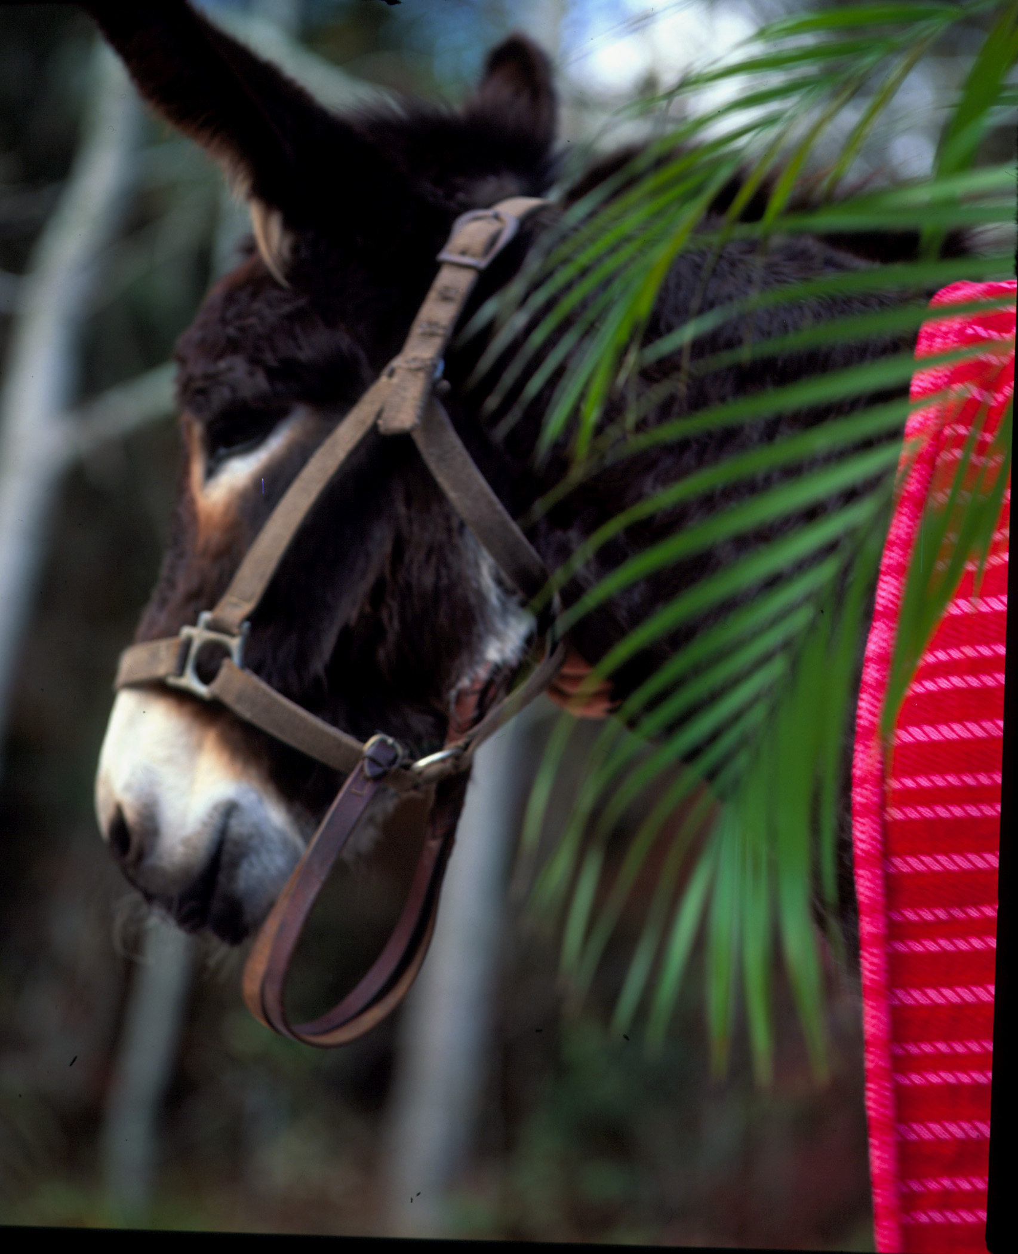
Zechariah 9:9-10 “Rejoice greatly, O Daughter of Zion! Shout, Daughter of Jerusalem! See, your king comes to you, righteous and having salvation, gentle and riding on a donkey, on a colt, the foal of a donkey. ¹⁰ I will take away the chariots from Ephraim and the war-horses from Jerusalem, and the battle bow will be broken. He will proclaim peace to the nations. His rule will extend from sea to sea and from the River to the ends of the earth.”
亚9:9-10 “锡安的民哪，应当大大喜乐。耶路撒冷的民哪，应当欢呼。看哪，你的王来到你这里。他是公义的，并且施行拯救，谦谦和和地骑着驴，就是骑着驴的驹子。我必除灭以法莲的战车，和耶路撒冷的战马。争战的弓也必除灭。他必向列国讲和平。他的权柄必从这海管到那海，从大河管到地极。”

Slide 17
“The king asked Ziba, “Why have you brought these?” Ziba answered, “The donkeys are for the king’s household to ride on….”” (2 Samuel 16:2)
“王问洗巴说，你带这些来是什么意思呢？洗巴说，驴是给王的家眷骑的。面饼和夏天的果饼是给少年人吃的。酒是给在旷野疲乏人喝的。”（撒下16:2）
“Take your lord’s servants with you and set Solomon my son on my own mule and take him down to Gihon.” (1 Kings 1:33)
“王对他们说，要带领你们主的仆人，使我儿子所罗门骑我的骡子，送他下到基训。” （王上1:33）
“He had forty sons and thirty grandsons, who rode on seventy donkeys. He led Israel eight years.” (Judges 12:14)
“他有四十个儿子，三十个孙子，骑着七十匹驴驹。押顿作以色列的士师八年。”（士12:14）

Slide 18
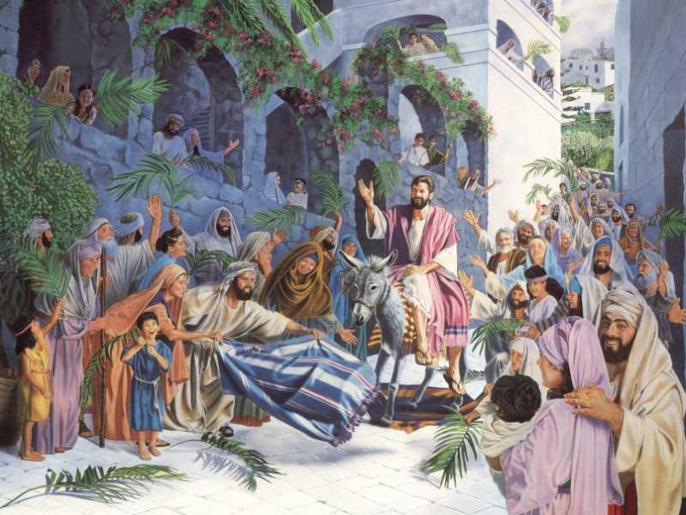

Slide 19
Zechariah 9:9-10 “Rejoice greatly, O Daughter of Zion! Shout, Daughter of Jerusalem! See, your king comes to you, righteous and having salvation, gentle and riding on a donkey, on a colt, the foal of a donkey. ¹⁰ I will take away the chariots from Ephraim and the war-horses from Jerusalem, and the battle bow will be broken. He will proclaim peace to the nations. His rule will extend from sea to sea and from the River to the ends of the earth.”
亚9:9-10 “锡安的民哪，应当大大喜乐。耶路撒冷的民哪，应当欢呼。看哪，你的王来到你这里。他是公义的，并且施行拯救，谦谦和和地骑着驴，就是骑着驴的驹子。我必除灭以法莲的战车，和耶路撒冷的战马。争战的弓也必除灭。他必向列国讲和平。他的权柄必从这海管到那海，从大河管到地极。”

Slide 20
“the sinful mind is hostile to God. It does not submit to God’s law, nor can it do so.” (Romans 8:7)
“原来体贴肉体的，就是与神为仇。因为不服神的律法，也是不能服。”（罗8:7）
“The kings of the earth take their stand and the rulers gather together against the LORD and against his Anointed One. “Let us break their chains,” they say, “and throw off their fetters.” (Psalm 2:2–4)
“世上的君王一齐起来，臣宰一同商议，要敌挡耶和华，并他的受膏者，说，我们要挣开他们的捆绑，脱去他们的绳索。那坐在天上的必发笑。主必嗤笑他们。”（诗2:2-4）
Zechariah 9:9-10 “Rejoice greatly, O Daughter of Zion! Shout, Daughter of Jerusalem! See, your king comes to you, righteous and having salvation, gentle and riding on a donkey, on a colt, the foal of a donkey. ¹⁰ I will take away the chariots from Ephraim and the war-horses from Jerusalem, and the battle bow will be broken. He will proclaim peace to the nations. His rule will extend from sea to sea and from the River to the ends of the earth.”
亚9:9-10
“锡安的民哪，应当大大喜乐。耶路撒冷的民哪，应当欢呼。看哪，你的王来到你这里。他是公义的，并且施行拯救，谦谦和和地骑着驴，就是骑着驴的驹子。我必除灭以法莲的战车，和耶路撒冷的战马。争战的弓也必除灭。他必向列国讲和平。他的权柄必从这海管到那海，从大河管到地极。”

Slide 21
“They will make war against the Lamb, but the Lamb will overcome them because he is Lord of lords and King of kings—and with him will be his called, chosen and faithful followers.”” (Revelation 17:14)
“他们与羔羊争战，羔羊必胜过他们，因为羔羊是万主之主，万王之王。同着羔羊的，就是蒙召被选有忠心的，也必得胜。”（启17：14）
Zechariah 9:9-10
“Rejoice greatly, O Daughter of Zion! Shout, Daughter of Jerusalem! See, your king comes to you, righteous and having salvation, gentle and riding on a donkey, on a colt, the foal of a donkey. ¹⁰ I will take away the chariots from Ephraim and the war-horses from Jerusalem, and the battle bow will be broken. He will proclaim peace to the nations. His rule will extend from sea to sea and from the River to the ends of the earth.”
亚9:9-10
“锡安的民哪，应当大大喜乐。耶路撒冷的民哪，应当欢呼。看哪，你的王来到你这里。他是公义的，并且施行拯救，谦谦和和地骑着驴，就是骑着驴的驹子。我必除灭以法莲的战车，和耶路撒冷的战马。争战的弓也必除灭。他必向列国讲和平。他的权柄必从这海管到那海，从大河管到地极。”
“Then I saw the beast and the kings of the earth and their armies gathered together to make war against the rider on the horse and his army.” (Revelation 19:19)
“我看见那兽，和地上的君王，并他们的众军，都聚集，要与骑白马的并他的军兵争战。”（启19:19）

Slide 22
Zechariah 9:9-10 “Rejoice greatly, O Daughter of Zion! Shout, Daughter of Jerusalem! See, your king comes to you, righteous and having salvation, gentle and riding on a donkey, on a colt, the foal of a donkey. ¹⁰ I will take away the chariots from Ephraim and the war-horses from Jerusalem, and the battle bow will be broken. He will proclaim peace to the nations. His rule will extend from sea to sea and from the River to the ends of the earth.”
亚9:9-10
“锡安的民哪，应当大大喜乐。耶路撒冷的民哪，应当欢呼。看哪，你的王来到你这里。他是公义的，并且施行拯救，谦谦和和地骑着驴，就是骑着驴的驹子。我必除灭以法莲的战车，和耶路撒冷的战马。争战的弓也必除灭。他必向列国讲和平。他的权柄必从这海管到那海，从大河管到地极。”
“Comfort, comfort my people, says your God. Speak tenderly to Jerusalem, and proclaim to her that her hard service has been completed, that her sin has been paid for, that she has received from the LORD’s hand double for all her sins.” (Isaiah 40:1–2)
“你们的神说，你们要安慰，安慰我的百姓。要对耶路撒冷说安慰的话，又向他宣告说，他争战的日子已满了，他的罪孽赦免了，他为自己的一切罪，从耶和华手中加倍受罚。”（赛40:1-2）

Slide 23
“he will proclaim peace”
“他必讲和平”
“Daughter, your faith has healed you. Go in peace and be freed from your suffering.” (Mark 5:34)
“女儿，你的信救了你，平平安安地回去吧。你的灾病痊愈了。”（可5:34）
“Jesus himself stood among them and said to them, “Peace be with you.” (Luke 24:36)
“耶稣亲自站在他们当中，说，愿你们平安。”（路24:36）
“Peace I leave with you; my peace I give you. I do not give to you as the world gives. Do not let your hearts be troubled and do not be afraid.” (John 14:27)
“我留下平安给你们，我将我的平安赐给你们。我所赐的，不像世人所赐的。你们心里不要忧愁，也不要胆怯。”（约14:27）
“Jesus came and stood among them and said, “Peace be with you!” (John 20:19)
“耶稣来站在当中，对他们说，愿你们平安。”（约20:19）

Slide 24
Luke 2:14: “Glory to God in the highest, And on earth peace, goodwill toward men!” (NKJV).
路2:14：“在至高之处荣耀归与神，在地上平安归与他所喜悦的人。”

Slide 25
Zechariah 9:9-10 “Rejoice greatly, O Daughter of Zion! Shout, Daughter of Jerusalem! See, your king comes to you, righteous and having salvation, gentle and riding on a donkey, on a colt, the foal of a donkey. ¹⁰ I will take away the chariots from Ephraim and the war-horses from Jerusalem, and the battle bow will be broken. He will proclaim peace to the nations. His rule will extend from sea to sea and from the River to the ends of the earth.”
亚9:9-10
“锡安的民哪，应当大大喜乐。耶路撒冷的民哪，应当欢呼。看哪，你的王来到你这里。他是公义的，并且施行拯救，谦谦和和地骑着驴，就是骑着驴的驹子。我必除灭以法莲的战车，和耶路撒冷的战马。争战的弓也必除灭。他必向列国讲和平。他的权柄必从这海管到那海，从大河管到地极。”

Slide 26
Zechariah 9:9-10
“Rejoice greatly, O Daughter of Zion! Shout, Daughter of Jerusalem! See, your king comes to you, righteous and having salvation, gentle and riding on a donkey, on a colt, the foal of a donkey. ¹⁰ I will take away the chariots from Ephraim and the war-horses from Jerusalem, and the battle bow will be broken. He will proclaim peace to the nations. His rule will extend from sea to sea and from the River to the ends of the earth.”
亚9:9-10
“锡安的民哪，应当大大喜乐。耶路撒冷的民哪，应当欢呼。看哪，你的王来到你这里。他是公义的，并且施行拯救，谦谦和和地骑着驴，就是骑着驴的驹子。我必除灭以法莲的战车，和耶路撒冷的战马。争战的弓也必除灭。他必向列国讲和平。他的权柄必从这海管到那海，从大河管到地极。”
“He will rule from sea to sea and from the River to the ends of the earth. The desert tribes will bow before him and his enemies will lick the dust. The kings of Tarshish and of distant shores will bring tribute to him; the kings of Sheba and Seba will present him gifts. All kings will bow down to him and all nations will serve him. For he will deliver the needy who cry out, the afflicted who have no one to help.” (Psalm 72:8–12)
“他要执掌权柄，从这海直到那海，从大河直到地极。住在旷野的，必在他面前下拜。他的仇敌，必要舔土。他施和海岛的王要进贡。示巴和西巴的王要献礼物。诸王都要叩拜他，万国都要事奉他。因为穷乏人呼求的时候，他要搭救，没有人帮助的困苦人，他也要搭救。”(诗 72:8–12)

Slide 27
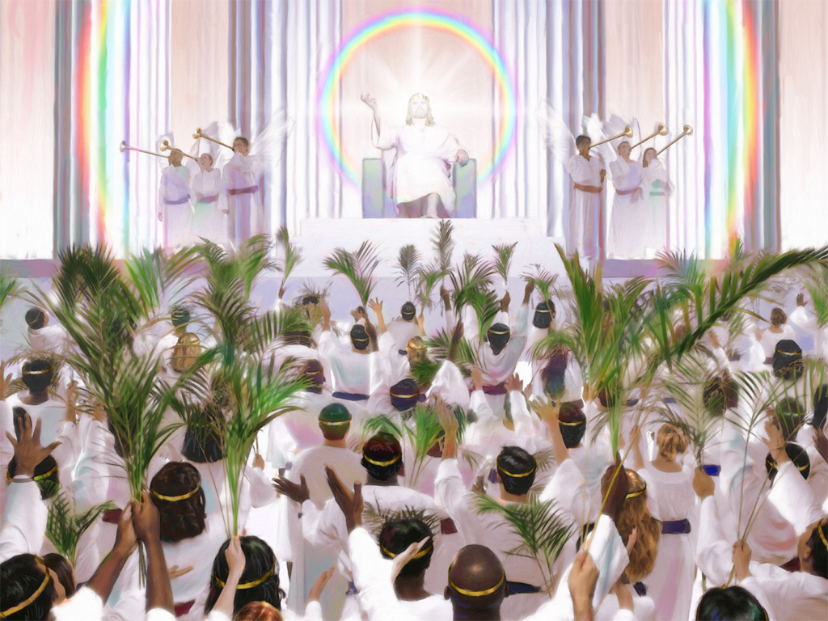
Zechariah 9:9-10 “Rejoice greatly, O Daughter of Zion! Shout, Daughter of Jerusalem! See, your king comes to you, righteous and having salvation, gentle and riding on a donkey, on a colt, the foal of a donkey. ¹⁰ I will take away the chariots from Ephraim and the war-horses from Jerusalem, and the battle bow will be broken. He will proclaim peace to the nations. His rule will extend from sea to sea and from the River to the ends of the earth.”
亚9:9-10
“锡安的民哪，应当大大喜乐。耶路撒冷的民哪，应当欢呼。看哪，你的王来到你这里。他是公义的，并且施行拯救，谦谦和和地骑着驴，就是骑着驴的驹子。我必除灭以法莲的战车，和耶路撒冷的战马。争战的弓也必除灭。他必向列国讲和平。他的权柄必从这海管到那海，从大河管到地极。”

Slide 28
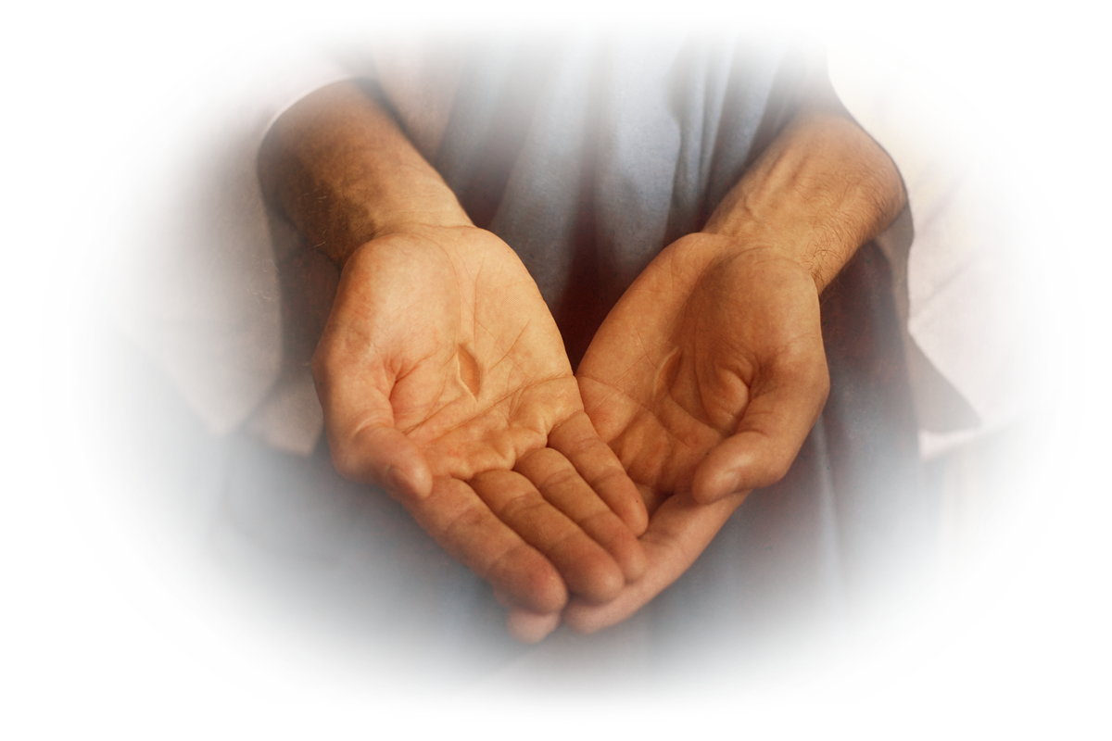
Zechariah 9:9-10
“Rejoice greatly, O Daughter of Zion! Shout, Daughter of Jerusalem! See, your king comes to you, righteous and having salvation, gentle and riding on a donkey, on a colt, the foal of a donkey. ¹⁰ I will take away the chariots from Ephraim and the war-horses from Jerusalem, and the battle bow will be broken. He will proclaim peace to the nations. His rule will extend from sea to sea and from the River to the ends of the earth.”
亚9:9-10
“锡安的民哪，应当大大喜乐。耶路撒冷的民哪，应当欢呼。看哪，你的王来到你这里。他是公义的，并且施行拯救，谦谦和和地骑着驴，就是骑着驴的驹子。我必除灭以法莲的战车，和耶路撒冷的战马。争战的弓也必除灭。他必向列国讲和平。他的权柄必从这海管到那海，从大河管到地极。”

Slide 29
10) What do we now know about the Messiah?
我们现在知道关于弥赛亚的什么信息？
We know that the Messiah will visit Jerusalem on a donkey.
我们知道，弥赛亚会骑着驴进耶路撒冷
We know that the Messiah will rescue himself and be victorious in the end.
我们知道，最终，弥赛亚会自救并且得胜。
We know that the Messiah will be a humble and righteous King.
我们知道，弥赛亚是谦卑公义的王。
We know that the Messiah will be a king whose rule will be universal.
我们知道，弥赛亚是全世界的王。

Slide 30
THE MESSENGER
OF THE COVENANT
立约的使者
Malachi 3:1-4
玛3:1-4

Slide 31
Malachi 3:1-4 “See, I will send my messenger, who will prepare the way before me. Then suddenly the Lord you are seeking will come to his temple; the messenger of the covenant, whom you desire, will come,” says the LORD Almighty. ² But who can endure the day of his coming? Who can stand when he appears? For he will be like a refiner’s fire or a launderer’s soap. ³ He will sit as a refiner and purifier of silver; he will purify the Levites and refine them like gold and silver. Then the LORD will have men who will bring offerings in righteousness, ⁴ and the offerings of Judah and Jerusalem will be acceptable to the LORD, as in days gone by, as in former years.”
玛3:1-4 万军之耶和华说，我要差遣我的使者，在我前面预备道路。你们所寻求的主，必忽然进入他的殿。立约的使者，就是你们所仰慕的，快要来到。他来的日子，谁能当得起呢？他显现的时候，谁能立得住呢？因为他如炼金之人的火，如漂布之人的碱。他必坐下如炼净银子的，必洁净利未人，熬炼他们像金银一样。他们就凭公义献供物给耶和华。那时，犹大和耶路撒冷所献的供物，必蒙耶和华悦纳，仿佛古时之日，上古之年。

Slide 32
Malachi 3:1-4 “See, I will send my messenger, who will prepare the way before me. Then suddenly the Lord you are seeking will come to his temple; the messenger of the covenant, whom you desire, will come,” says the LORD Almighty. ² But who can endure the day of his coming? Who can stand when he appears? For he will be like a refiner’s fire or a launderer’s soap. ³ He will sit as a refiner and purifier of silver; he will purify the Levites and refine them like gold and silver. Then the LORD will have men who will bring offerings in righteousness, ⁴ and the offerings of Judah and Jerusalem will be acceptable to the LORD, as in days gone by, as in former years.”
玛3:1-4 万军之耶和华说，我要差遣我的使者，在我前面预备道路。你们所寻求的主，必忽然进入他的殿。立约的使者，就是你们所仰慕的，快要来到。他来的日子，谁能当得起呢？他显现的时候，谁能立得住呢？因为他如炼金之人的火，如漂布之人的碱。他必坐下如炼净银子的，必洁净利未人，熬炼他们像金银一样。他们就凭公义献供物给耶和华。那时，犹大和耶路撒冷所献的供物，必蒙耶和华悦纳，仿佛古时之日，上古之年。

Slide 33
“malakhi”
Malachi 3:1-4 “See, I will send my messenger, who will prepare the way before me. Then suddenly the Lord you are seeking will come to his temple; the messenger of the covenant, whom you desire, will come,” says the LORD Almighty. ² But who can endure the day of his coming? Who can stand when he appears? For he will be like a refiner’s fire or a launderer’s soap. ³ He will sit as a refiner and purifier of silver; he will purify the Levites and refine them like gold and silver. Then the LORD will have men who will bring offerings in righteousness, ⁴ and the offerings of Judah and Jerusalem will be acceptable to the LORD, as in days gone by, as in former years.”
玛3:1-4 万军之耶和华说，我要差遣我的使者，在我前面预备道路。你们所寻求的主，必忽然进入他的殿。立约的使者，就是你们所仰慕的，快要来到。他来的日子，谁能当得起呢？他显现的时候，谁能立得住呢？因为他如炼金之人的火，如漂布之人的碱。他必坐下如炼净银子的，必洁净利未人，熬炼他们像金银一样。他们就凭公义献供物给耶和华。那时，犹大和耶路撒冷所献的供物，必蒙耶和华悦纳，仿佛古时之日，上古之年。
“malakhi”
“For the lips of a priest ought to preserve knowledge, and from his mouth men should seek instruction—because he is the messenger of the LORD Almighty.” (Malachi 2:7)
“祭司的嘴里当存知识，人也当由他口中寻求律法，因为他是万军之耶和华的使者。”（玛2:7）

Slide 34
“malakhi”
Malachi 3:1-4
“See, I will send my messenger, who will prepare the way before me. Then suddenly the Lord you are seeking will come to his temple; the messenger of the covenant, whom you desire, will come,” says the LORD Almighty. ² But who can endure the day of his coming? Who can stand when he appears? For he will be like a refiner’s fire or a launderer’s soap. ³ He will sit as a refiner and purifier of silver; he will purify the Levites and refine them like gold and silver. Then the LORD will have men who will bring offerings in righteousness, ⁴ and the offerings of Judah and Jerusalem will be acceptable to the LORD, as in days gone by, as in former years.”
玛3:1-4
万军之耶和华说，我要差遣我的使者，在我前面预备道路。你们所寻求的主，必忽然进入他的殿。立约的使者，就是你们所仰慕的，快要来到。他来的日子，谁能当得起呢？他显现的时候，谁能立得住呢？因为他如炼金之人的火，如漂布之人的碱。他必坐下如炼净银子的，必洁净利未人，熬炼他们像金银一样。他们就凭公义献供物给耶和华。那时，犹大和耶路撒冷所献的供物，必蒙耶和华悦纳，仿佛古时之日，上古之年。
“Praise be to the God of Shadrach, Meshach and Abednego, who has sent his angel (malakh) and rescued his servants! They trusted in him and defied the king’s command and were willing to give up their lives rather than serve or worship any god except their own God.” (Daniel 3:28)
“尼布甲尼撒说，沙得拉，米煞，亚伯尼歌的神是应当称颂的。他差遣使者(malakh)救护倚靠他的仆人，他们不遵王命，舍去己身，在他们神以外不肯事奉敬拜别神。”（但3:28）
“malakhi”

Slide 35
Malachi 3:1-4 “See, I will send my messenger, who will prepare the way before me. Then suddenly the Lord you are seeking will come to his temple; the messenger of the covenant, whom you desire, will come,” says the LORD Almighty. ² But who can endure the day of his coming? Who can stand when he appears? For he will be like a refiner’s fire or a launderer’s soap. ³ He will sit as a refiner and purifier of silver; he will purify the Levites and refine them like gold and silver. Then the LORD will have men who will bring offerings in righteousness, ⁴ and the offerings of Judah and Jerusalem will be acceptable to the LORD, as in days gone by, as in former years.”
玛3:1-4 万军之耶和华说，我要差遣我的使者，在我前面预备道路。你们所寻求的主，必忽然进入他的殿。立约的使者，就是你们所仰慕的，快要来到。他来的日子，谁能当得起呢？他显现的时候，谁能立得住呢？因为他如炼金之人的火，如漂布之人的碱。他必坐下如炼净银子的，必洁净利未人，熬炼他们像金银一样。他们就凭公义献供物给耶和华。那时，犹大和耶路撒冷所献的供物，必蒙耶和华悦纳，仿佛古时之日，上古之年。

Slide 36
Malachi 3:1-4 “See, I will send my messenger, who will prepare the way before me. Then suddenly the Lord you are seeking will come to his temple; the messenger of the covenant, whom you desire, will come,” says the LORD Almighty. ² But who can endure the day of his coming? Who can stand when he appears? For he will be like a refiner’s fire or a launderer’s soap. ³ He will sit as a refiner and purifier of silver; he will purify the Levites and refine them like gold and silver. Then the LORD will have men who will bring offerings in righteousness, ⁴ and the offerings of Judah and Jerusalem will be acceptable to the LORD, as in days gone by, as in former years.”
玛3:1-4 万军之耶和华说，我要差遣我的使者，在我前面预备道路。你们所寻求的主，必忽然进入他的殿。立约的使者，就是你们所仰慕的，快要来到。他来的日子，谁能当得起呢？他显现的时候，谁能立得住呢？因为他如炼金之人的火，如漂布之人的碱。他必坐下如炼净银子的，必洁净利未人，熬炼他们像金银一样。他们就凭公义献供物给耶和华。那时，犹大和耶路撒冷所献的供物，必蒙耶和华悦纳，仿佛古时之日，上古之年。
“As John’s disciples were leaving, Jesus began to speak to the crowd about John: “What did you go out into the desert to see? A reed swayed by the wind? If not, what did you go out to see? A man dressed in fine clothes? No, those who wear fine clothes are in kings’ palaces. Then what did you go out to see? A prophet? Yes, I tell you, and more than a prophet. This is the one about whom it is written: ‘I will send my messenger ahead of you, who will prepare your way before you.’” (Matthew 11:7–10)
“他们走的时候，耶稣就对众人讲论约翰说，你们从前出到旷野，是要看什么呢？要看风吹动的芦苇吗？你们出去，到底是要看什么，要看穿细软衣服的人吗？那穿细软衣服的人，是在王宫里。你们出去，究竟是为什么，是要看先知吗？我告诉你们，是的，他比先知大多了。经上记着说，我要差遣我的使者在你前面，预备道路。所说的就是这个人。” (太 11:7–10)

Slide 37
Malachi 3:1-4 “See, I will send my messenger, who will prepare the way before me. Then suddenly the Lord you are seeking will come to his temple; the messenger of the covenant, whom you desire, will come,” says the LORD Almighty. ² But who can endure the day of his coming? Who can stand when he appears? For he will be like a refiner’s fire or a launderer’s soap. ³ He will sit as a refiner and purifier of silver; he will purify the Levites and refine them like gold and silver. Then the LORD will have men who will bring offerings in righteousness, ⁴ and the offerings of Judah and Jerusalem will be acceptable to the LORD, as in days gone by, as in former years.”
玛3:1-4 万军之耶和华说，我要差遣我的使者，在我前面预备道路。你们所寻求的主，必忽然进入他的殿。立约的使者，就是你们所仰慕的，快要来到。他来的日子，谁能当得起呢？他显现的时候，谁能立得住呢？因为他如炼金之人的火，如漂布之人的碱。他必坐下如炼净银子的，必洁净利未人，熬炼他们像金银一样。他们就凭公义献供物给耶和华。那时，犹大和耶路撒冷所献的供物，必蒙耶和华悦纳，仿佛古时之日，上古之年。
“For all the Prophets and the Law prophesied until John. And if you are willing to accept it, he is the Elijah who was to come.” (Matthew 11:13–14). “因为众先知和律法说预言，到约翰为止。你们若肯领受，这人就是那应当来的以利亚。”（太11:13-14）
“But I tell you, Elijah has already come, and they did not recognize him, but have done to him everything they wished. In the same way the Son of Man is going to suffer at their hands.” Then the disciples understood that he was talking to them about John the Baptist.” (Matthew 17:12–13)
“只是我告诉你们，以利亚已经来了，人却不认识他，竟任意待他。人子也将要这样受他们的害。门徒这才明白耶稣所说的，是指着施洗的约翰。”（太17:12-13）
“See, I will send you the prophet Elijah before that great and dreadful day of the LORD comes.” (Malachi 4:5)
“看哪，耶和华大而可畏之日未到以前，我必差遣先知以利亚到你们那里去。”（玛4:5）

Slide 38
Malachi 3:1-4 “See, I will send my messenger, who will prepare the way before me. Then suddenly the Lord you are seeking will come to his temple; the messenger of the covenant, whom you desire, will come,” says the LORD Almighty. ² But who can endure the day of his coming? Who can stand when he appears? For he will be like a refiner’s fire or a launderer’s soap. ³ He will sit as a refiner and purifier of silver; he will purify the Levites and refine them like gold and silver. Then the LORD will have men who will bring offerings in righteousness, ⁴ and the offerings of Judah and Jerusalem will be acceptable to the LORD, as in days gone by, as in former years.”
玛3:1-4 万军之耶和华说，我要差遣我的使者，在我前面预备道路。你们所寻求的主，必忽然进入他的殿。立约的使者，就是你们所仰慕的，快要来到。他来的日子，谁能当得起呢？他显现的时候，谁能立得住呢？因为他如炼金之人的火，如漂布之人的碱。他必坐下如炼净银子的，必洁净利未人，熬炼他们像金银一样。他们就凭公义献供物给耶和华。那时，犹大和耶路撒冷所献的供物，必蒙耶和华悦纳，仿佛古时之日，上古之年。
“In those days John the Baptist came, preaching in the Desert of Judea and saying, “Repent, for the kingdom of heaven is near.” (Matthew 3:1–2)
“那时，有施洗的约翰出来，在犹太的旷野传道，说，天国近了，你们应当悔改。”（太3:1-2）

Slide 39
REPENT
悔改
Confess/admit
忏悔/承认
Be sorry/regret
抱歉/后悔
Commit to change
决心改变

Slide 40
Malachi 3:1-4 “See, I will send my messenger, who will prepare the way before me. Then suddenly the Lord you are seeking will come to his temple; the messenger of the covenant, whom you desire, will come,” says the LORD Almighty. ² But who can endure the day of his coming? Who can stand when he appears? For he will be like a refiner’s fire or a launderer’s soap. ³ He will sit as a refiner and purifier of silver; he will purify the Levites and refine them like gold and silver. Then the LORD will have men who will bring offerings in righteousness, ⁴ and the offerings of Judah and Jerusalem will be acceptable to the LORD, as in days gone by, as in former years.”
玛3:1-4 万军之耶和华说，我要差遣我的使者，在我前面预备道路。你们所寻求的主，必忽然进入他的殿。立约的使者，就是你们所仰慕的，快要来到。他来的日子，谁能当得起呢？他显现的时候，谁能立得住呢？因为他如炼金之人的火，如漂布之人的碱。他必坐下如炼净银子的，必洁净利未人，熬炼他们像金银一样。他们就凭公义献供物给耶和华。那时，犹大和耶路撒冷所献的供物，必蒙耶和华悦纳，仿佛古时之日，上古之年。

Slide 41
Malachi 3:1-4 “See, I will send my messenger, who will prepare the way before me. Then suddenly the Lord you are seeking will come to his temple; the messenger of the covenant, whom you desire, will come,” says the LORD Almighty. ² But who can endure the day of his coming? Who can stand when he appears? For he will be like a refiner’s fire or a launderer’s soap. ³ He will sit as a refiner and purifier of silver; he will purify the Levites and refine them like gold and silver. Then the LORD will have men who will bring offerings in righteousness, ⁴ and the offerings of Judah and Jerusalem will be acceptable to the LORD, as in days gone by, as in former years.”
玛3:1-4 万军之耶和华说，我要差遣我的使者，在我前面预备道路。你们所寻求的主，必忽然进入他的殿。立约的使者，就是你们所仰慕的，快要来到。他来的日子，谁能当得起呢？他显现的时候，谁能立得住呢？因为他如炼金之人的火，如漂布之人的碱。他必坐下如炼净银子的，必洁净利未人，熬炼他们像金银一样。他们就凭公义献供物给耶和华。那时，犹大和耶路撒冷所献的供物，必蒙耶和华悦纳，仿佛古时之日，上古之年。
“Then the angel (malakh) of God, who had been traveling in front of Israel’s army, withdrew and went behind them. The pillar of cloud also moved from in front and stood behind them, coming between the armies of Egypt and Israel. Throughout the night the cloud brought darkness to the one side and light to the other side; so neither went near the other all night long.” (Exodus 14:19–20)
“在以色列营前行走神的使者(malakh) ，转到他们后边去，云柱也从他们前边转到他们后边立住。在埃及营和以色列营中间有云柱，一边黑暗，一边发光，终夜两下不得相近。” (出 14:19–20)

Slide 42
Malachi 3:1-4 “See, I will send my messenger, who will prepare the way before me. Then suddenly the Lord you are seeking will come to his temple; the messenger of the covenant, whom you desire, will come,” says the LORD Almighty. ² But who can endure the day of his coming? Who can stand when he appears? For he will be like a refiner’s fire or a launderer’s soap. ³ He will sit as a refiner and purifier of silver; he will purify the Levites and refine them like gold and silver. Then the LORD will have men who will bring offerings in righteousness, ⁴ and the offerings of Judah and Jerusalem will be acceptable to the LORD, as in days gone by, as in former years.”
玛3:1-4 万军之耶和华说，我要差遣我的使者，在我前面预备道路。你们所寻求的主，必忽然进入他的殿。立约的使者，就是你们所仰慕的，快要来到。他来的日子，谁能当得起呢？他显现的时候，谁能立得住呢？因为他如炼金之人的火，如漂布之人的碱。他必坐下如炼净银子的，必洁净利未人，熬炼他们像金银一样。他们就凭公义献供物给耶和华。那时，犹大和耶路撒冷所献的供物，必蒙耶和华悦纳，仿佛古时之日，上古之年。
“That night the angel (malakh) of the LORD went out and put to death a hundred and eighty-five thousand men in the Assyrian camp. When the people got up the next morning—there were all the dead bodies!” (2 Kings 19:35)
“当夜，耶和华的使者(malakh)出去，在亚述营中杀了十八万五千人。清早有人起来，一看，都是死尸了。” (王下 19:35)

Slide 43
Malachi 3:1-4 “See, I will send my messenger, who will prepare the way before me. Then suddenly the Lord you are seeking will come to his temple; the messenger of the covenant, whom you desire, will come,” says the LORD Almighty. ² But who can endure the day of his coming? Who can stand when he appears? For he will be like a refiner’s fire or a launderer’s soap. ³ He will sit as a refiner and purifier of silver; he will purify the Levites and refine them like gold and silver. Then the LORD will have men who will bring offerings in righteousness, ⁴ and the offerings of Judah and Jerusalem will be acceptable to the LORD, as in days gone by, as in former years.”
玛3:1-4 万军之耶和华说，我要差遣我的使者，在我前面预备道路。你们所寻求的主，必忽然进入他的殿。立约的使者，就是你们所仰慕的，快要来到。他来的日子，谁能当得起呢？他显现的时候，谁能立得住呢？因为他如炼金之人的火，如漂布之人的碱。他必坐下如炼净银子的，必洁净利未人，熬炼他们像金银一样。他们就凭公义献供物给耶和华。那时，犹大和耶路撒冷所献的供物，必蒙耶和华悦纳，仿佛古时之日，上古之年。
“See, I am sending an angel (malakh) ahead of you to guard you along the way and to bring you to the place I have prepared. Pay attention to him and listen to what he says. Do not rebel against him; he will not forgive your rebellion, since my Name is in him. If you listen carefully to what he says and do all that I say, I will be an enemy to your enemies and will oppose those who oppose you. My angel will go ahead of you and bring you into the land of the Amorites, Hittites, Perizzites, Canaanites, Hivites and Jebusites, and I will wipe them out.” (Exodus 23:20–23)
“看哪，我差遣使者(malakh)在你前面，在路上保护你，领你到我所预备的地方去。他是奉我名来的，你们要在他面前谨慎，听从他的话，不可惹他，因为他必不赦免你们的过犯。你若实在听从他的话，照着我一切所说的去行，我就向你的仇敌作仇敌，向你的敌人作敌人。我的使者要在你前面行，领你到亚摩利人，赫人，比利洗人，迦南人，希未人，耶布斯人那里去，我必将他们剪除。(出 23:20–23)

Slide 44
Malachi 3:1-4 “See, I will send my messenger, who will prepare the way before me. Then suddenly the Lord you are seeking will come to his temple; the messenger of the covenant, whom you desire, will come,” says the LORD Almighty. ² But who can endure the day of his coming? Who can stand when he appears? For he will be like a refiner’s fire or a launderer’s soap. ³ He will sit as a refiner and purifier of silver; he will purify the Levites and refine them like gold and silver. Then the LORD will have men who will bring offerings in righteousness, ⁴ and the offerings of Judah and Jerusalem will be acceptable to the LORD, as in days gone by, as in former years.”
玛3:1-4 万军之耶和华说，我要差遣我的使者，在我前面预备道路。你们所寻求的主，必忽然进入他的殿。立约的使者，就是你们所仰慕的，快要来到。他来的日子，谁能当得起呢？他显现的时候，谁能立得住呢？因为他如炼金之人的火，如漂布之人的碱。他必坐下如炼净银子的，必洁净利未人，熬炼他们像金银一样。他们就凭公义献供物给耶和华。那时，犹大和耶路撒冷所献的供物，必蒙耶和华悦纳，仿佛古时之日，上古之年。
“Are you for us or for our enemies?” “Neither,” he replied, “but as commander of the army of the LORD I have now come.” Then Joshua fell facedown to the ground in reverence, and asked him, “What message does my Lord have for his servant?” (Joshua 5:13–14)
“你是帮助我们呢？是帮助我们敌人呢？他回答说，不是的，我来是要作耶和华军队的元帅。约书亚就俯伏在地下拜，说，我主有什么话吩咐仆人。” (书 5:13–14)

Slide 45
Malachi 3:1-4 “See, I will send my messenger, who will prepare the way before me. Then suddenly the Lord you are seeking will come to his temple; the messenger of the covenant, whom you desire, will come,” says the LORD Almighty. ² But who can endure the day of his coming? Who can stand when he appears? For he will be like a refiner’s fire or a launderer’s soap. ³ He will sit as a refiner and purifier of silver; he will purify the Levites and refine them like gold and silver. Then the LORD will have men who will bring offerings in righteousness, ⁴ and the offerings of Judah and Jerusalem will be acceptable to the LORD, as in days gone by, as in former years.”
玛3:1-4 万军之耶和华说，我要差遣我的使者，在我前面预备道路。你们所寻求的主，必忽然进入他的殿。立约的使者，就是你们所仰慕的，快要来到。他来的日子，谁能当得起呢？他显现的时候，谁能立得住呢？因为他如炼金之人的火，如漂布之人的碱。他必坐下如炼净银子的，必洁净利未人，熬炼他们像金银一样。他们就凭公义献供物给耶和华。那时，犹大和耶路撒冷所献的供物，必蒙耶和华悦纳，仿佛古时之日，上古之年。
“The time is coming,” declares the Lord, “when I will make a new covenant with the house of Israel and with the house of Judah … for I will forgive their wickedness and will remember their sins no more.” (Jeremiah 31:31-34)
“耶和华说，日子将到，我要与以色列家和犹大家另立新约……我要赦免他们的罪孽，不再记念他们的罪恶。”（耶31:31-34）

Slide 46
Malachi 3:1-4 “See, I will send my messenger, who will prepare the way before me. Then suddenly the Lord you are seeking will come to his temple; the messenger of the covenant, whom you desire, will come,” says the LORD Almighty. ² But who can endure the day of his coming? Who can stand when he appears? For he will be like a refiner’s fire or a launderer’s soap. ³ He will sit as a refiner and purifier of silver; he will purify the Levites and refine them like gold and silver. Then the LORD will have men who will bring offerings in righteousness, ⁴ and the offerings of Judah and Jerusalem will be acceptable to the LORD, as in days gone by, as in former years.”
玛3:1-4 万军之耶和华说，我要差遣我的使者，在我前面预备道路。你们所寻求的主，必忽然进入他的殿。立约的使者，就是你们所仰慕的，快要来到。他来的日子，谁能当得起呢？他显现的时候，谁能立得住呢？因为他如炼金之人的火，如漂布之人的碱。他必坐下如炼净银子的，必洁净利未人，熬炼他们像金银一样。他们就凭公义献供物给耶和华。那时，犹大和耶路撒冷所献的供物，必蒙耶和华悦纳，仿佛古时之日，上古之年。
“This cup is the new covenant in my blood, which is poured out for you.” (Luke 22:20)
“饭后也照样拿起杯来，说，这杯是用我血所立的新约，是为你们流出来的。”（路22:20）

Slide 47
Malachi 3:1-4 “See, I will send my messenger, who will prepare the way before me. Then suddenly the Lord you are seeking will come to his temple; the messenger of the covenant, whom you desire, will come,” says the LORD Almighty. ² But who can endure the day of his coming? Who can stand when he appears? For he will be like a refiner’s fire or a launderer’s soap. ³ He will sit as a refiner and purifier of silver; he will purify the Levites and refine them like gold and silver. Then the LORD will have men who will bring offerings in righteousness, ⁴ and the offerings of Judah and Jerusalem will be acceptable to the LORD, as in days gone by, as in former years.”
玛3:1-4 万军之耶和华说，我要差遣我的使者，在我前面预备道路。你们所寻求的主，必忽然进入他的殿。立约的使者，就是你们所仰慕的，快要来到。他来的日子，谁能当得起呢？他显现的时候，谁能立得住呢？因为他如炼金之人的火，如漂布之人的碱。他必坐下如炼净银子的，必洁净利未人，熬炼他们像金银一样。他们就凭公义献供物给耶和华。那时，犹大和耶路撒冷所献的供物，必蒙耶和华悦纳，仿佛古时之日，上古之年。

Slide 48
Malachi 3:1-4 “See, I will send my messenger, who will prepare the way before me. Then suddenly the Lord you are seeking will come to his temple; the messenger of the covenant, whom you desire, will come,” says the LORD Almighty. ² But who can endure the day of his coming? Who can stand when he appears? For he will be like a refiner’s fire or a launderer’s soap. ³ He will sit as a refiner and purifier of silver; he will purify the Levites and refine them like gold and silver. Then the LORD will have men who will bring offerings in righteousness, ⁴ and the offerings of Judah and Jerusalem will be acceptable to the LORD, as in days gone by, as in former years.”
玛3:1-4 万军之耶和华说，我要差遣我的使者，在我前面预备道路。你们所寻求的主，必忽然进入他的殿。立约的使者，就是你们所仰慕的，快要来到。他来的日子，谁能当得起呢？他显现的时候，谁能立得住呢？因为他如炼金之人的火，如漂布之人的碱。他必坐下如炼净银子的，必洁净利未人，熬炼他们像金银一样。他们就凭公义献供物给耶和华。那时，犹大和耶路撒冷所献的供物，必蒙耶和华悦纳，仿佛古时之日，上古之年。
“You know very well that the day of the Lord will come like a thief in the night.” (1 Thessalonians 5:2) “因为你们自己明明晓得，主的日子来到，好像夜间的贼一样。”（帖前5:2）
“But understand this: If the owner of the house had known at what time of night the thief was coming, he would have kept watch and would not have let his house be broken into. So you also must be ready, because the Son of Man will come at an hour when you do not expect him.” (Matthew 24:43–44)
“家主若知道几更天有贼来，就必儆醒，不容人挖透房屋。这是你们所知道的。所以你们也要预备。因为你们想不到的时候，人子就来了。”（太24:43-44）

Slide 49
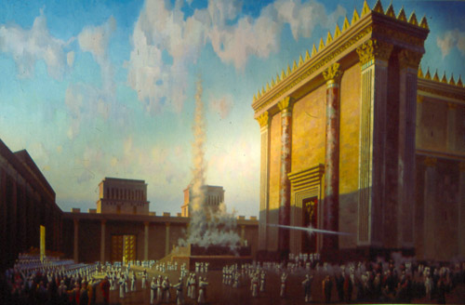
Malachi 3:1-4 “See, I will send my messenger, who will prepare the way before me. Then suddenly the Lord you are seeking will come to his temple; the messenger of the covenant, whom you desire, will come,” says the LORD Almighty. ² But who can endure the day of his coming? Who can stand when he appears? For he will be like a refiner’s fire or a launderer’s soap. ³ He will sit as a refiner and purifier of silver; he will purify the Levites and refine them like gold and silver. Then the LORD will have men who will bring offerings in righteousness, ⁴ and the offerings of Judah and Jerusalem will be acceptable to the LORD, as in days gone by, as in former years.”
玛3:1-4 万军之耶和华说，我要差遣我的使者，在我前面预备道路。你们所寻求的主，必忽然进入他的殿。立约的使者，就是你们所仰慕的，快要来到。他来的日子，谁能当得起呢？他显现的时候，谁能立得住呢？因为他如炼金之人的火，如漂布之人的碱。他必坐下如炼净银子的，必洁净利未人，熬炼他们像金银一样。他们就凭公义献供物给耶和华。那时，犹大和耶路撒冷所献的供物，必蒙耶和华悦纳，仿佛古时之日，上古之年。

Slide 50
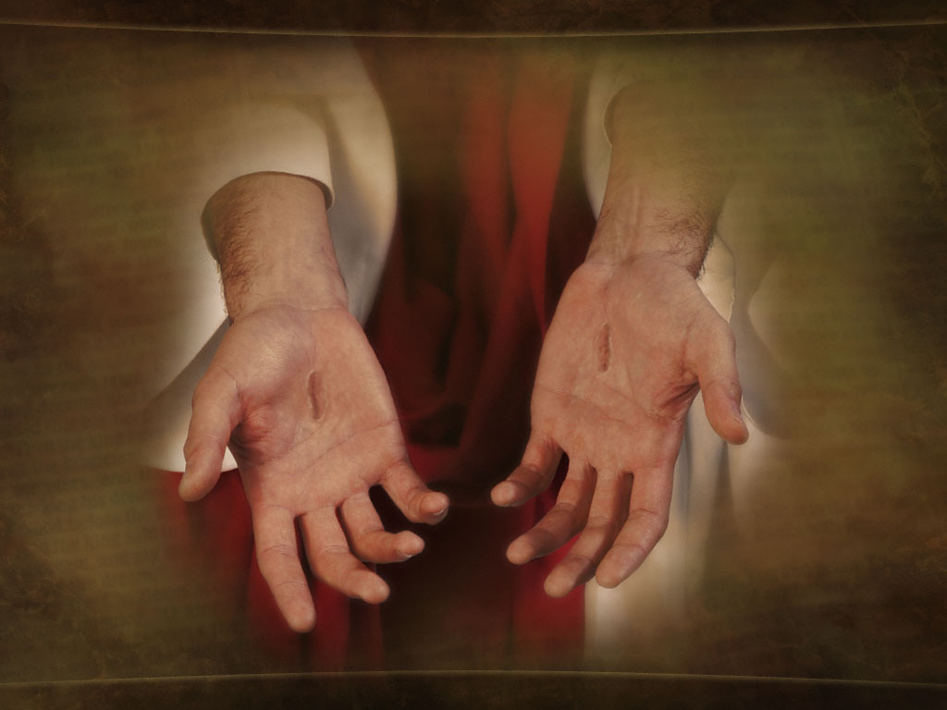
Malachi 3:1-4 “See, I will send my messenger, who will prepare the way before me. Then suddenly the Lord you are seeking will come to his temple; the messenger of the covenant, whom you desire, will come,” says the LORD Almighty. ² But who can endure the day of his coming? Who can stand when he appears? For he will be like a refiner’s fire or a launderer’s soap. ³ He will sit as a refiner and purifier of silver; he will purify the Levites and refine them like gold and silver. Then the LORD will have men who will bring offerings in righteousness, ⁴ and the offerings of Judah and Jerusalem will be acceptable to the LORD, as in days gone by, as in former years.”
玛3:1-4 万军之耶和华说，我要差遣我的使者，在我前面预备道路。你们所寻求的主，必忽然进入他的殿。立约的使者，就是你们所仰慕的，快要来到。他来的日子，谁能当得起呢？他显现的时候，谁能立得住呢？因为他如炼金之人的火，如漂布之人的碱。他必坐下如炼净银子的，必洁净利未人，熬炼他们像金银一样。他们就凭公义献供物给耶和华。那时，犹大和耶路撒冷所献的供物，必蒙耶和华悦纳，仿佛古时之日，上古之年。

Slide 51
Malachi 3:1-4 “See, I will send my messenger, who will prepare the way before me. Then suddenly the Lord you are seeking will come to his temple; the messenger of the covenant, whom you desire, will come,” says the LORD Almighty. ² But who can endure the day of his coming? Who can stand when he appears? For he will be like a refiner’s fire or a launderer’s soap. ³ He will sit as a refiner and purifier of silver; he will purify the Levites and refine them like gold and silver. Then the LORD will have men who will bring offerings in righteousness, ⁴ and the offerings of Judah and Jerusalem will be acceptable to the LORD, as in days gone by, as in former years.”
玛3:1-4 万军之耶和华说，我要差遣我的使者，在我前面预备道路。你们所寻求的主，必忽然进入他的殿。立约的使者，就是你们所仰慕的，快要来到。他来的日子，谁能当得起呢？他显现的时候，谁能立得住呢？因为他如炼金之人的火，如漂布之人的碱。他必坐下如炼净银子的，必洁净利未人，熬炼他们像金银一样。他们就凭公义献供物给耶和华。那时，犹大和耶路撒冷所献的供物，必蒙耶和华悦纳，仿佛古时之日，上古之年。

Slide 52
Malachi 3:1-4 “See, I will send my messenger, who will prepare the way before me. Then suddenly the Lord you are seeking will come to his temple; the messenger of the covenant, whom you desire, will come,” says the LORD Almighty. ² But who can endure the day of his coming? Who can stand when he appears? For he will be like a refiner’s fire or a launderer’s soap. ³ He will sit as a refiner and purifier of silver; he will purify the Levites and refine them like gold and silver. Then the LORD will have men who will bring offerings in righteousness, ⁴ and the offerings of Judah and Jerusalem will be acceptable to the LORD, as in days gone by, as in former years.”
玛3:1-4 万军之耶和华说，我要差遣我的使者，在我前面预备道路。你们所寻求的主，必忽然进入他的殿。立约的使者，就是你们所仰慕的，快要来到。他来的日子，谁能当得起呢？他显现的时候，谁能立得住呢？因为他如炼金之人的火，如漂布之人的碱。他必坐下如炼净银子的，必洁净利未人，熬炼他们像金银一样。他们就凭公义献供物给耶和华。那时，犹大和耶路撒冷所献的供物，必蒙耶和华悦纳，仿佛古时之日，上古之年。

Slide 53
Malachi 3:1-4
“See, I will send my messenger, who will prepare the way before me. Then suddenly the Lord you are seeking will come to his temple; the messenger of the covenant, whom you desire, will come,” says the LORD Almighty. ² But who can endure the day of his coming? Who can stand when he appears? For he will be like a refiner’s fire or a launderer’s soap. ³ He will sit as a refiner and purifier of silver; he will purify the Levites and refine them like gold and silver. Then the LORD will have men who will bring offerings in righteousness, ⁴ and the offerings of Judah and Jerusalem will be acceptable to the LORD, as in days gone by, as in former years.”
玛3:1-4
万军之耶和华说，我要差遣我的使者，在我前面预备道路。你们所寻求的主，必忽然进入他的殿。立约的使者，就是你们所仰慕的，快要来到。他来的日子，谁能当得起呢？他显现的时候，谁能立得住呢？因为他如炼金之人的火，如漂布之人的碱。他必坐下如炼净银子的，必洁净利未人，熬炼他们像金银一样。他们就凭公义献供物给耶和华。那时，犹大和耶路撒冷所献的供物，必蒙耶和华悦纳，仿佛古时之日，上古之年。
“They called to the mountains and the rocks, “Fall on us and hide us from the face of him who sits on the throne and from the wrath of the Lamb! For the great day of their wrath has come, and who can stand?” (Revelation 6:16–17)
“向山和岩石说，倒在我们身上吧，把我们藏起来，躲避坐宝座者的面目，和羔羊的忿怒。因为他们忿怒的大日到了，谁能站得住呢？”（启6:16-17）

Slide 54
Malachi 3:1-4 “See, I will send my messenger, who will prepare the way before me. Then suddenly the Lord you are seeking will come to his temple; the messenger of the covenant, whom you desire, will come,” says the LORD Almighty. ² But who can endure the day of his coming? Who can stand when he appears? For he will be like a refiner’s fire or a launderer’s soap. ³ He will sit as a refiner and purifier of silver; he will purify the Levites and refine them like gold and silver. Then the LORD will have men who will bring offerings in righteousness, ⁴ and the offerings of Judah and Jerusalem will be acceptable to the LORD, as in days gone by, as in former years.”
玛3:1-4 万军之耶和华说，我要差遣我的使者，在我前面预备道路。你们所寻求的主，必忽然进入他的殿。立约的使者，就是你们所仰慕的，快要来到。他来的日子，谁能当得起呢？他显现的时候，谁能立得住呢？因为他如炼金之人的火，如漂布之人的碱。他必坐下如炼净银子的，必洁净利未人，熬炼他们像金银一样。他们就凭公义献供物给耶和华。那时，犹大和耶路撒冷所献的供物，必蒙耶和华悦纳，仿佛古时之日，上古之年。
“Surely the day is coming; it will burn like a furnace. All the arrogant and every evildoer will be stubble, and that day that is coming will set them on fire,” says the LORD Almighty. “Not a root or a branch will be left to them.” (Malachi 4:1)
“万军之耶和华说，那日临近，势如烧着的火炉。凡狂傲的和行恶的必如碎秸。在那日必被烧尽，根本枝条一无存留。”（玛4:1）

Slide 55
Malachi 3:1-4 “See, I will send my messenger, who will prepare the way before me. Then suddenly the Lord you are seeking will come to his temple; the messenger of the covenant, whom you desire, will come,” says the LORD Almighty. ² But who can endure the day of his coming? Who can stand when he appears? For he will be like a refiner’s fire or a launderer’s soap. ³ He will sit as a refiner and purifier of silver; he will purify the Levites and refine them like gold and silver. Then the LORD will have men who will bring offerings in righteousness, ⁴ and the offerings of Judah and Jerusalem will be acceptable to the LORD, as in days gone by, as in former years.”
玛3:1-4 万军之耶和华说，我要差遣我的使者，在我前面预备道路。你们所寻求的主，必忽然进入他的殿。立约的使者，就是你们所仰慕的，快要来到。他来的日子，谁能当得起呢？他显现的时候，谁能立得住呢？因为他如炼金之人的火，如漂布之人的碱。他必坐下如炼净银子的，必洁净利未人，熬炼他们像金银一样。他们就凭公义献供物给耶和华。那时，犹大和耶路撒冷所献的供物，必蒙耶和华悦纳，仿佛古时之日，上古之年。
“See, I have refined you, though not as silver; I have tested you in the furnace of affliction.” (Isaiah 48:10)
“我熬炼你，却不像熬炼银子。你在苦难的炉中，我拣选你。” (赛48:10)

Slide 56
“The crucible for silver and the furnace for gold, but the LORD tests the heart.” (Proverbs 17:3)
“鼎为炼银，炉为炼金。惟有耶和华熬炼人心。”
“But he knows the way that I take; when he has tested me, I will come forth as gold.” (Job 23:10)
“然而他知道我所行的路。他试炼我之后，我必如精金。”
“This third I will bring into the fire; I will refine them like silver and test them like gold. They will call on my name and I will answer them; I will say, ‘They are my people,’ and they will say, ‘The LORD is our God.’” (Zechariah 13:9)
“我要使这三分之一经火，熬炼他们，如熬炼银子，试炼他们，如试炼金子。他们必求告我的名，我必应允他们。我要说，这是我的子民。他们也要说，耶和华是我们的神。”（亚13:9）

Slide 57
“These have come so that your faith—of greater worth than gold, which perishes even though refined by fire—may be proved genuine and may result in praise, glory and honor when Jesus Christ is revealed.” (1 Peter 1:7)
“叫你们的信心既被试验，就比那被火试验，仍然能坏的金子，更显宝贵。可以在耶稣基督显现的时候，得着称赞，荣耀，尊贵。”（彼前1:7）

Slide 58
“Let both grow together until the harvest. At that time I will tell the harvesters: First collect the weeds and tie them in bundles to be burned; then gather the wheat and bring it into my barn.’” (Matthew 13:30)
“容这两样一齐长，等着收割。当收割的时候，我要对收割的人说，先将稗子薅出来，捆成捆，留着烧。惟有麦子，要收在仓里。”（太13:30）

Slide 59
Malachi 3:1-4 “See, I will send my messenger, who will prepare the way before me. Then suddenly the Lord you are seeking will come to his temple; the messenger of the covenant, whom you desire, will come,” says the LORD Almighty. ² But who can endure the day of his coming? Who can stand when he appears? For he will be like a refiner’s fire or a launderer’s soap. ³ He will sit as a refiner and purifier of silver; he will purify the Levites and refine them like gold and silver. Then the LORD will have men who will bring offerings in righteousness, ⁴ and the offerings of Judah and Jerusalem will be acceptable to the LORD, as in days gone by, as in former years.”
玛3:1-4 万军之耶和华说，我要差遣我的使者，在我前面预备道路。你们所寻求的主，必忽然进入他的殿。立约的使者，就是你们所仰慕的，快要来到。他来的日子，谁能当得起呢？他显现的时候，谁能立得住呢？因为他如炼金之人的火，如漂布之人的碱。他必坐下如炼净银子的，必洁净利未人，熬炼他们像金银一样。他们就凭公义献供物给耶和华。那时，犹大和耶路撒冷所献的供物，必蒙耶和华悦纳，仿佛古时之日，上古之年。
“Although you wash yourself with an abundance of soap, the stain of your guilt is still before me,” declares the Sovereign Lord. (Jeremiah 2:22)

Slide 60
Malachi 3:1-4 “See, I will send my messenger, who will prepare the way before me. Then suddenly the Lord you are seeking will come to his temple; the messenger of the covenant, whom you desire, will come,” says the LORD Almighty. ² But who can endure the day of his coming? Who can stand when he appears? For he will be like a refiner’s fire or a launderer’s soap. ³ He will sit as a refiner and purifier of silver; he will purify the Levites and refine them like gold and silver. Then the LORD will have men who will bring offerings in righteousness, ⁴ and the offerings of Judah and Jerusalem will be acceptable to the LORD, as in days gone by, as in former years.”
玛3:1-4 万军之耶和华说，我要差遣我的使者，在我前面预备道路。你们所寻求的主，必忽然进入他的殿。立约的使者，就是你们所仰慕的，快要来到。他来的日子，谁能当得起呢？他显现的时候，谁能立得住呢？因为他如炼金之人的火，如漂布之人的碱。他必坐下如炼净银子的，必洁净利未人，熬炼他们像金银一样。他们就凭公义献供物给耶和华。那时，犹大和耶路撒冷所献的供物，必蒙耶和华悦纳，仿佛古时之日，上古之年。
“The blood of Jesus cleanses us from all sin.” (1 John 1:7)
“他儿子耶稣的血也洗净我们一切的罪。” （约一1:7）

Slide 61
Malachi 3:1-4 “See, I will send my messenger, who will prepare the way before me. Then suddenly the Lord you are seeking will come to his temple; the messenger of the covenant, whom you desire, will come,” says the LORD Almighty. ² But who can endure the day of his coming? Who can stand when he appears? For he will be like a refiner’s fire or a launderer’s soap. ³ He will sit as a refiner and purifier of silver; he will purify the Levites and refine them like gold and silver. Then the LORD will have men who will bring offerings in righteousness, ⁴ and the offerings of Judah and Jerusalem will be acceptable to the LORD, as in days gone by, as in former years.”
玛3:1-4 万军之耶和华说，我要差遣我的使者，在我前面预备道路。你们所寻求的主，必忽然进入他的殿。立约的使者，就是你们所仰慕的，快要来到。他来的日子，谁能当得起呢？他显现的时候，谁能立得住呢？因为他如炼金之人的火，如漂布之人的碱。他必坐下如炼净银子的，必洁净利未人，熬炼他们像金银一样。他们就凭公义献供物给耶和华。那时，犹大和耶路撒冷所献的供物，必蒙耶和华悦纳，仿佛古时之日，上古之年。

Slide 62
MALACHI 3:1-4
玛3:1-4
20) What do we now know about the Messiah?
我们现在知道关于弥赛亚的什么信息？
The Messiah will be preceded by a “messenger” who will prepare people for him.
弥赛亚来之前将有一位“使者”为他预备道路。
The Messiah will come suddenly.
弥赛亚会忽然来到。
The Messiah will be a “messenger of a covenant.”
弥赛亚是“立约的使者”。
The Messiah will cleanse and purify.
弥赛亚要进行炼净洁净的工作。

