Slide 1

给万民施洗
BAPTISM FOR ALL NATIONS
洗礼的圣经学习
A Bible Study of Baptism

Slide 2
介绍
Introductions

Slide 3
开始祷告
Opening Prayer

Slide 4
学习提纲
Outline of Our Study
1.洗礼这词的意义
The Meaning Of The Word “Baptism”
2. 约翰洗礼的事工和施洗的仪式
Ceremonial Washings and the Ministry of John the Baptist
3.耶稣的洗礼
The Baptism of Jesus
4. 基督设立的洗礼研究所
The Baptism Instituted by Christ
早期基督徒的洗礼实践
The Practice of Baptism among Early Christians

Slide 5
学习提纲（继续）
Outline of Our Study (Continued）
6.今日洗礼的实行
The Practice of Baptism Today
7. 洗礼与原罪
Baptism and Original Sin
8. 洗礼与信仰
Baptism and Faith
9. 执行洗礼
Performing Baptisms

Slide 6
这课程的目的
The purposes of this course
更多了解有关圣经中的洗礼
  To learn more about baptism in the Bible
对我们自己的洗礼增加感恩
  To grow in appreciation for our own baptism
如同使徒的教导，我们要学习发展的洗礼
  To learn to live out our baptism as the apostles teach us
我们自己要做好准备回答每个人的任何问题，为什么我们相信并且我们为什么要做所做的事情
  To prepare ourselves to give an answer to anyone who asks why we believe and do what we do

Slide 7
“施洗”和“洗礼”
“baptize” and “baptism”
新约希腊词：βαπτίζω
NT Greek word : βαπτίζω
在NT使用了100 次
Used 100 times in the NT
总是直译，但有 3 个例外
Always transliterated, with 3 exceptions

Slide 8
βαπτίζω
马可福音7:3-4（原来法利赛人和犹太人都拘守古人的遗传，若不仔细洗[νίψωνται]手就不吃饭;从市上来,若不洗[βαπτίσωνται]浴也不吃饭;还有好些别的规矩,他们历代拘守,就是洗[βαπτισμοὺς]杯、罐、铜器等物.）
  Mark 7:3-4 The Pharisees and all the Jews do not eat unless they give their hands a ceremonial washing [Gr: νίψωνται], holding to the tradition of the elders. ⁴ When they come from the marketplace they do not eat unless they wash [Gr: βαπτίσωνται]. And they observe many other traditions, such as the washing [Gr: βαπτισμοὺς] of cups, pitchers and kettles.
路加福音 11:38-39 这法利赛人看见耶稣饭前不洗[ἐβαπτίσθη]手便诧异。 主对他说：“如今你们法利赛人洗净杯盘的外面，你们里面却满了勒索和邪恶。
  Luke 11:38-39 “But the Pharisee, noticing that Jesus did not first wash [Gr:ἐβαπτίσθη] before the meal, was surprised. Then the Lord said to him, “Now then, you Pharisees clean the outside of the cup and dish, but inside you are full of greed and wickedness.”

Slide 9
希伯来书 9:10 这些事，连那饮食和诸般洗濯的规矩，都不过是属肉体的条例，命定到振兴的时候为止。
  Hebrews 9:10 They are only a matter of food and drink and various ceremonial washings [Gr: βαπτισμοῖς] —external regulations applying until the time of the new order.
路加福音 11:38-39 这法利赛人看见耶稣饭前不洗[ἐβαπτίσθη]手便诧异。 39 主对他说：“如今你们法利赛人洗净杯盘的外面，你们里面却满了勒索和邪恶。
  Luke 11:38-39 But the Pharisee, noticing that Jesus did not first wash [Gr: ἐβαπτίσθη] before the meal, was surprised. Then the Lord said to him, “Now then, you Pharisees clean the outside of the cup and dish, but inside you are full of greed and wickedness.”

Slide 10
马可福音 7:3-4
（原来法利赛人和犹太人都拘守古人的遗传，若不仔细洗[νίψωνται]手就不吃饭； 4 从市上来，若不洗[βαπτίσωνται]浴也不吃饭；还有好些别的规矩，他们历代拘守，就是洗[βαπτισμοὺς]杯、罐、铜器等物。）
Mark 7:3-4
The Pharisees and all the Jews do not eat unless they give their hands a ceremonial washing [Gr: νίψωνται], holding to the tradition of the elders. 4 When they come from the marketplace they do not eat unless they wash [Gr: βαπτίσωνται]. And they observe many other traditions, such as the washing [Gr: βαπτισμοὺς] of cups, pitchers and kettles.¹
¹ Some early manuscripts have “pitchers, kettles, and dining couches.”

Slide 11
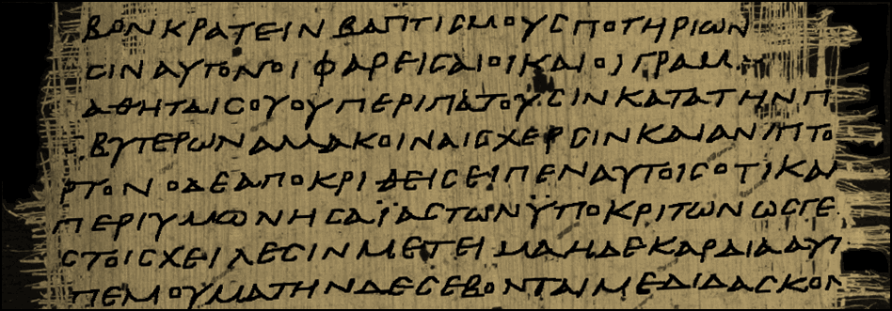
在马可福音7:4 里 p45（餐椅不见了）
Mark 7:4 in p45 (dining couches is missing)

Slide 12
你能泡在“餐椅”吗？
Can you dunk a “dining couch?”
考据一条规则说，更短的阅读是首选。 该规则将排除用餐沙发。
  One rule of textual criticism says that the shorter reading is preferred. That rule would leave out and dining couches.
另一条规则说，更难阅读是首选。 该规则将包括用餐沙发。
  Another rule says that the harder reading is preferred. That rule would include and dining couches.
还一条规则是说，最古老和最好的手稿具有优先权。 证据在最古老和最好的手稿中几乎平均分配。
  Another rule says that the oldest and best manuscripts carry preference. The evidence is split almost equally among the oldest and best manuscripts.

Slide 13
使徒行传 19:1-5
亚波罗在哥林多的时候，保罗经过了上边一带地方，就来到以弗所。在那里遇见几个门徒， ² 问他们说：“你们信的时候受了圣灵没有？”他们回答说：“没有，也未曾听见有圣灵赐下来。” ³ 保罗说：“这样，你们受的是什么洗(βάπτισμα)呢？”他们说：“是约翰的洗(βάπτισμα)。” ⁴ 保罗说：“约翰所行的是悔改的洗，告诉百姓当信那在他以后要来的，就是耶稣。” ⁵ 他们听见这话，就奉主耶稣的名受洗(ἐβαπτίσθησαν)。
ACTS 19:1-5
While Apollos was at Corinth, Paul took the road through the interior and arrived at Ephesus. There he found some disciples and asked them, “Did you receive the Holy Spirit when you believed?” They answered, “No, we have not even heard that there is a Holy Spirit.”
So Paul asked, “Then what baptism did you receive?”
“John’s baptism (βάπτισμα),” they replied.
Paul said, “John’s baptism (βάπτισμα) was a baptism of repentance. He told the people to believe in the one coming after him, that is, in Jesus.” On hearing this, they were baptized (ἐβαπτίσθησαν) into the name of the Lord Jesus.”

Slide 14
使徒行传 2:17
‘神说：在末后的日子，我要将我的灵浇灌凡有血气的，你们的儿女要说预言，你们的少年 人要见异象，老年人要做异梦。
ACTS 2:17
“In the last days, God says, I will pour out my Spirit on all people.”
浇 “baptism”
Notes:
Your sons and daughters will prophesy,
your young men will see visions,
your old men will dream dreams.

Slide 15
“洗礼”或“施洗”的定义
A definition of “baptism” or “baptize”
洗或应用水
  To wash or apply water

Slide 16
“洗礼”一词的其他用法
Other Uses of the Term “Baptism”
马太福音 3:11
“我是用水给你们施洗，叫你们悔改；但那在我以后来的，能力比我更大，我就是给他提鞋也不配，他要用圣灵与火给你们施洗。
Matthew 3:11
“I baptize you with water for repentance. But after me will come one who is more powerful than I, whose sandals I am not fit to carry. He will baptize you with the Holy Spirit and with fire.”

Slide 17
“洗礼”一词的其他用法
Other Uses of the Term “Baptism”
路加福音 12:49-50
“我来要把火丢在地上，倘若已经着起来，不也是我所愿意的吗？ 我有当受的洗还没有成就，我是何等地迫切呢！
Luke 12:49-50
“I have come to bring fire on the earth, and how I wish it were already kindled! But I have a baptism to undergo, and how distressed I am until it is completed!”

Slide 18
“洗礼”一词的其他用法
Other Uses of the Term “Baptism”
哥林多前书 10:1-2
弟兄们，我不愿意你们不晓得：我们的祖宗从前都在云下，都从海中经过，都在云里、海里受洗归了摩西，
1 Corinthians 10:1-2
“For I do not want you to be unaware, brethren, that our fathers were all under the cloud and all passed through the sea; and all were baptized into Moses in the cloud and in the sea.”

Slide 19
家庭作业
Homework

